Slide 1
RAPID SERVER-SIDE FULL STACK WEB DEVELOPMENT WITH VIEWCOMPONENTS AND HTMX
Thomas Schuehly
18. May 2023

Slide 2

Thomas Schühly
Spring Boot + Kotlin = ❤️
Blogging on tschuehly.de
Process Automation Software Engineer @mimacom Germany in Stuttgart
Freelance Web Developer
Open-Source Developer:
github.com/tschuehly/spring-view-component
github.com/tschuehly/supabase-security-spring-boot-starter

Slide 3
Would you describe yourself as a Software Engineer?

Slide 4
Software Engineering

Slide 5
Software Engineering

Slide 6




https://www.davefarley.net/
https://www.youtube.com/@ContinuousDelivery

Slide 7
Engineering
„Stifling Bureaucracy and heavy weight process control“
„Simply writing code and nothing else“
Dave Farley
What is Modern Software Engineering?

Slide 8
“In other disciplines, Engineering is simply the stuff that works. It is practical, pragmatic and more, not less, efficient.”
Dave Farley
What is Modern Software Engineering?

Slide 9
“The systems that modern engineers create are increasingly complex and sophisticated, [ .. ] modern software engineering, needs to focus us on managing that complexity”
Dave Farley
What is Modern Software Engineering?

Slide 10
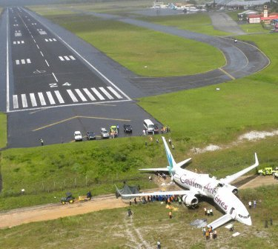



Slide 11
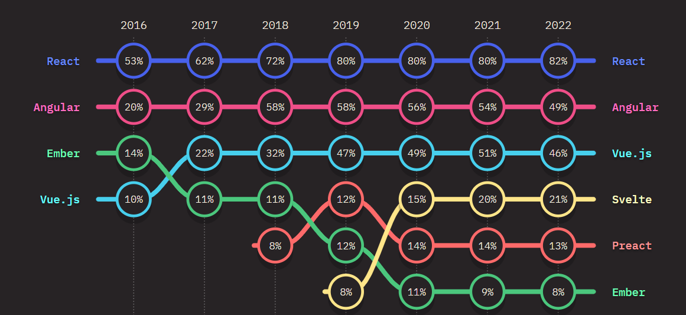
FRONT-END FRAMEWORKS USAGE OVER TIME

Slide 12
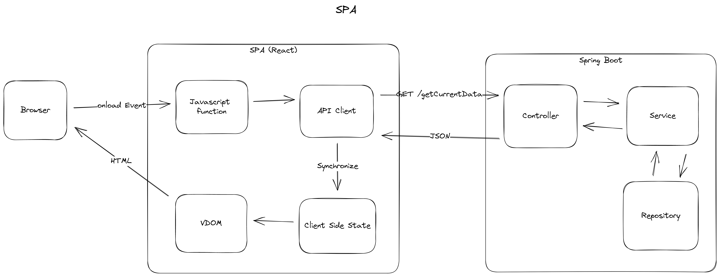
Single Page Application

Slide 13
After years of relative stability, many are now beginning to question the status quo. [..] on the server Astro, Remix and Next.js (among others) are making us reconsider how much code we really need to ship to the client.”
State of JS 2022
https://2022.stateofjs.com/

Slide 14

Do we need the complexity of “modern” JavaScript frameworks for building on the web?

Slide 15
Tom MacWright
“There is a sweet spot of React: in moderately interactive interfaces. Complex forms that require immediate feedback, UIs that need to move around and react instantly.”
Second-guessing the modern web
https://macwright.com/2020/05/10/spa-fatigue.html

Slide 16
thoughtworks Technology Radar Vol. 27
Single Page Applications are an architectural style
Tradeoffs analysis are skipped
Many Websites will benefit from the simplicity of server-side logic

Slide 17
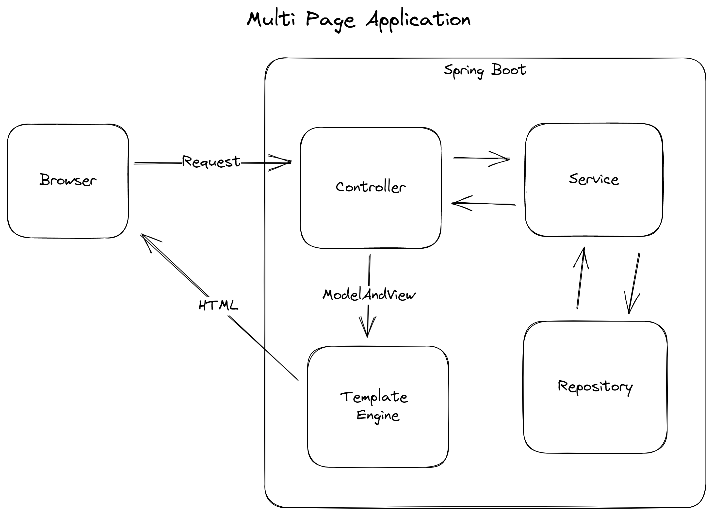

Slide 18
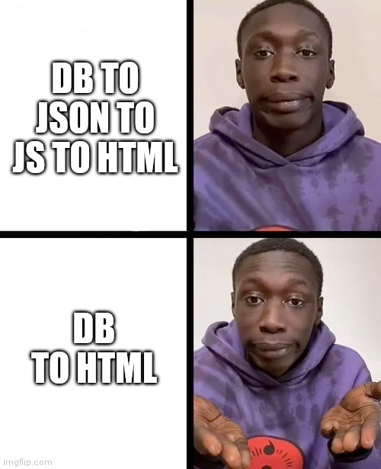

Slide 19
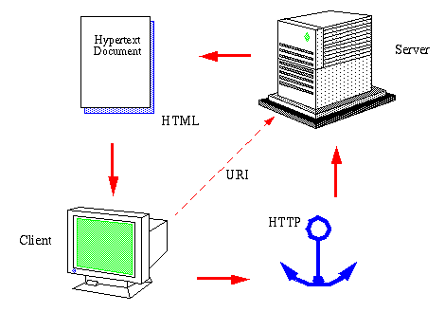
The World Wide Web
Henrik Frystyk
July 1994
https://www.w3.org/People/Frystyk/thesis/WWW.html

Slide 20
“Hypermedia is defined by the presence of application control information embedded within, or as a layer above, the presentation of information.”
Roy Fielding
Architectural Styles and
the Design of Network-based Software Architectures

Slide 21
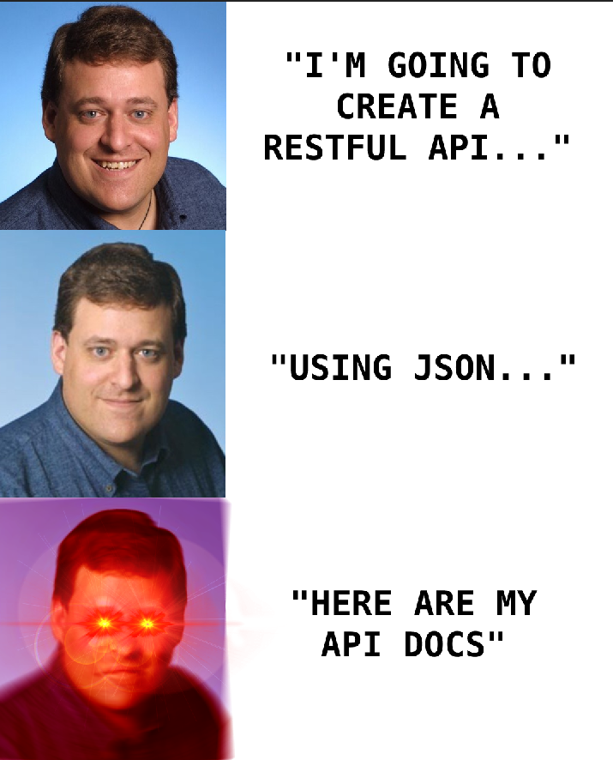
HATEOAS
The forgotten part of REST

Slide 22
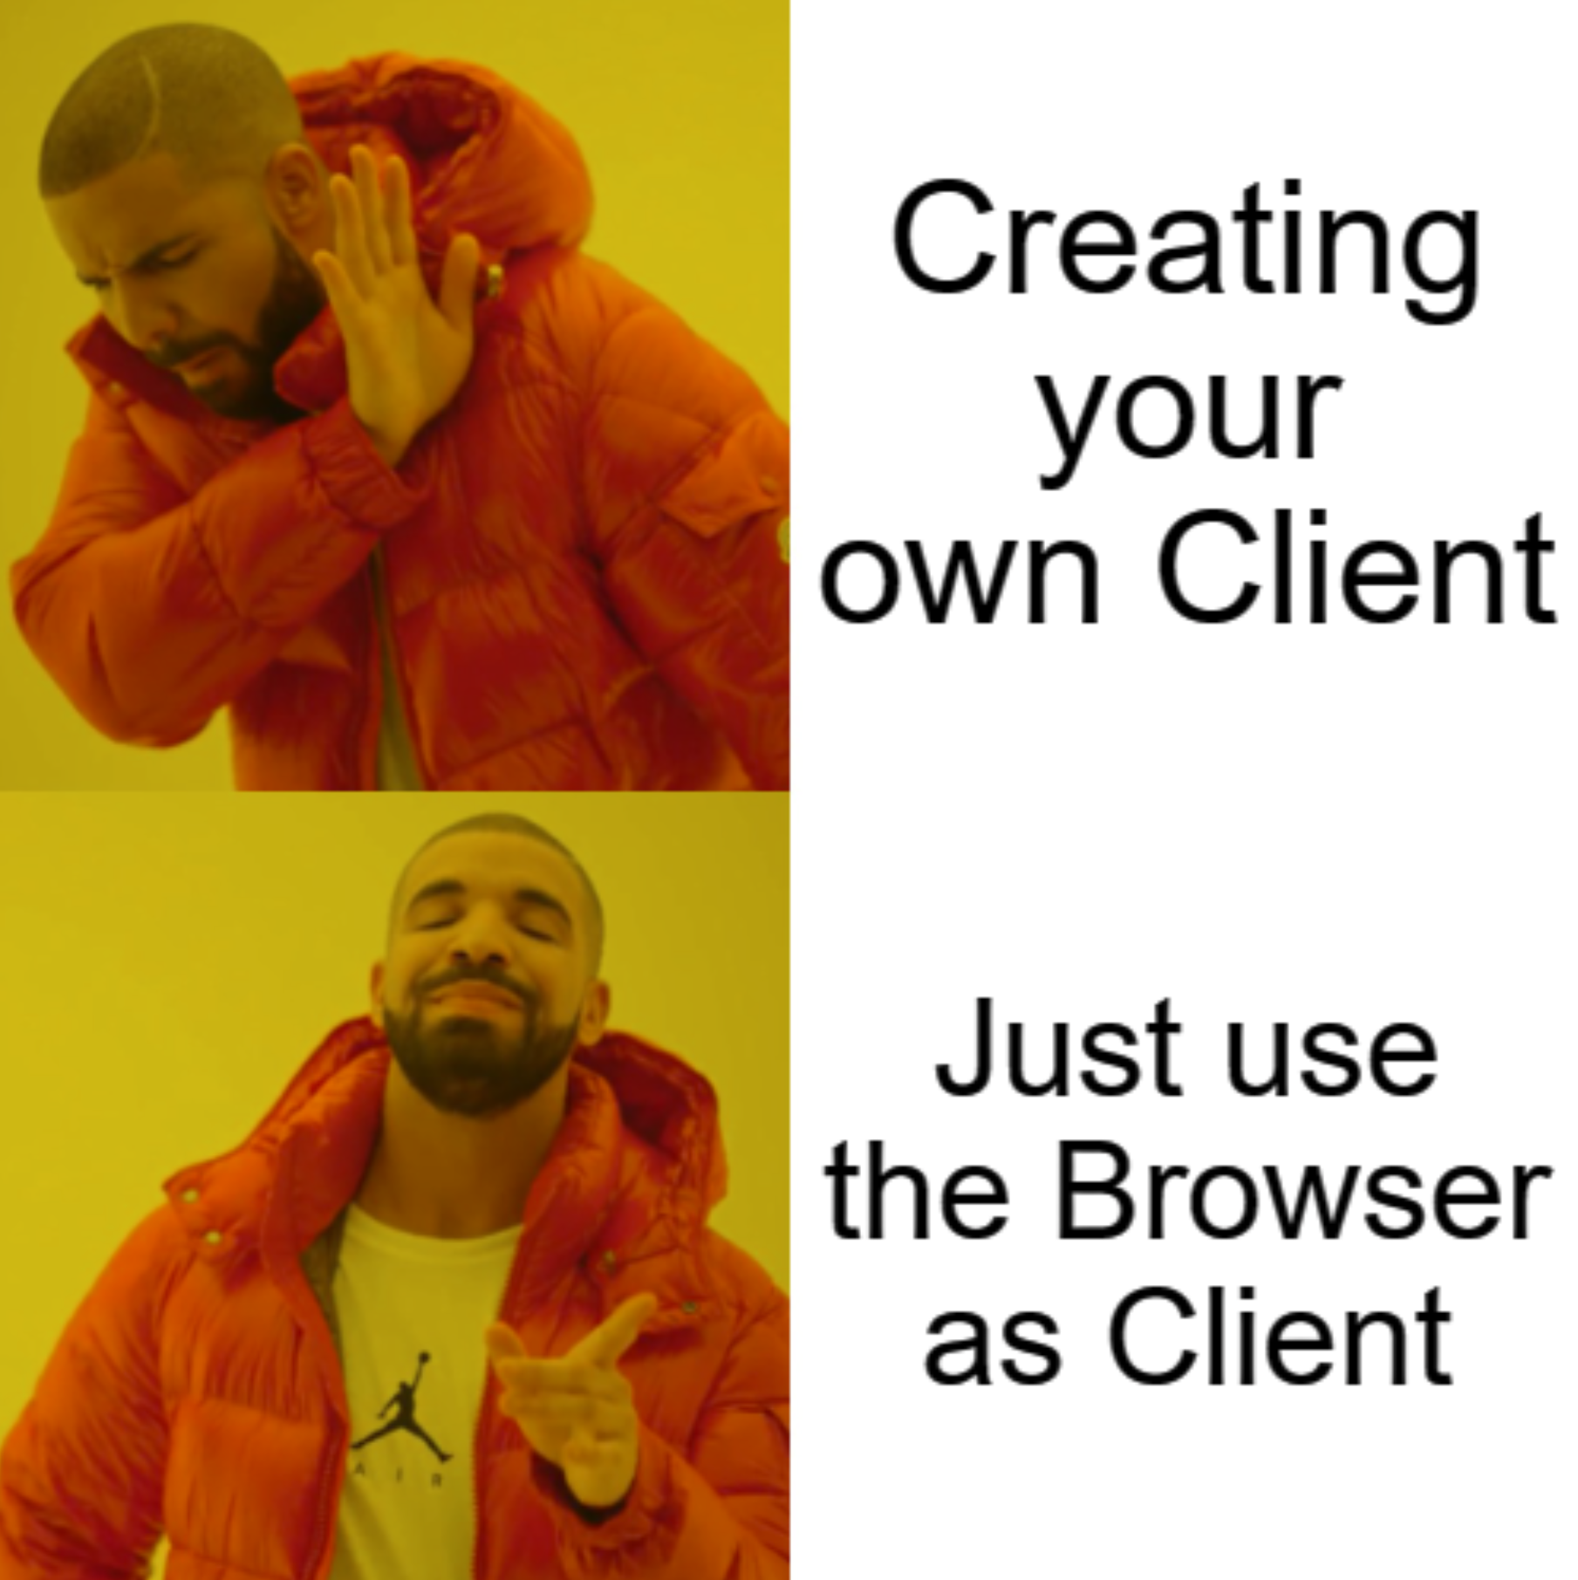

Slide 23


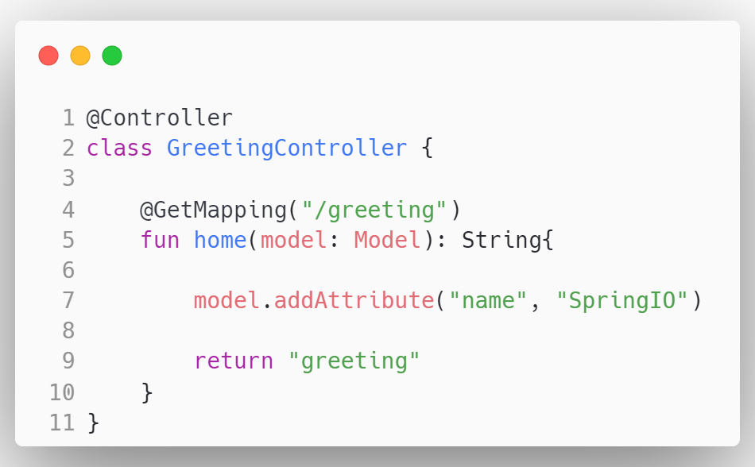

Slide 27
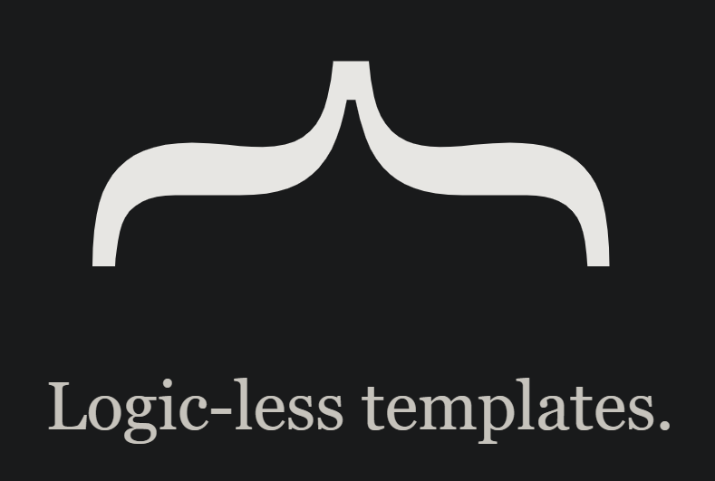




Slide 29
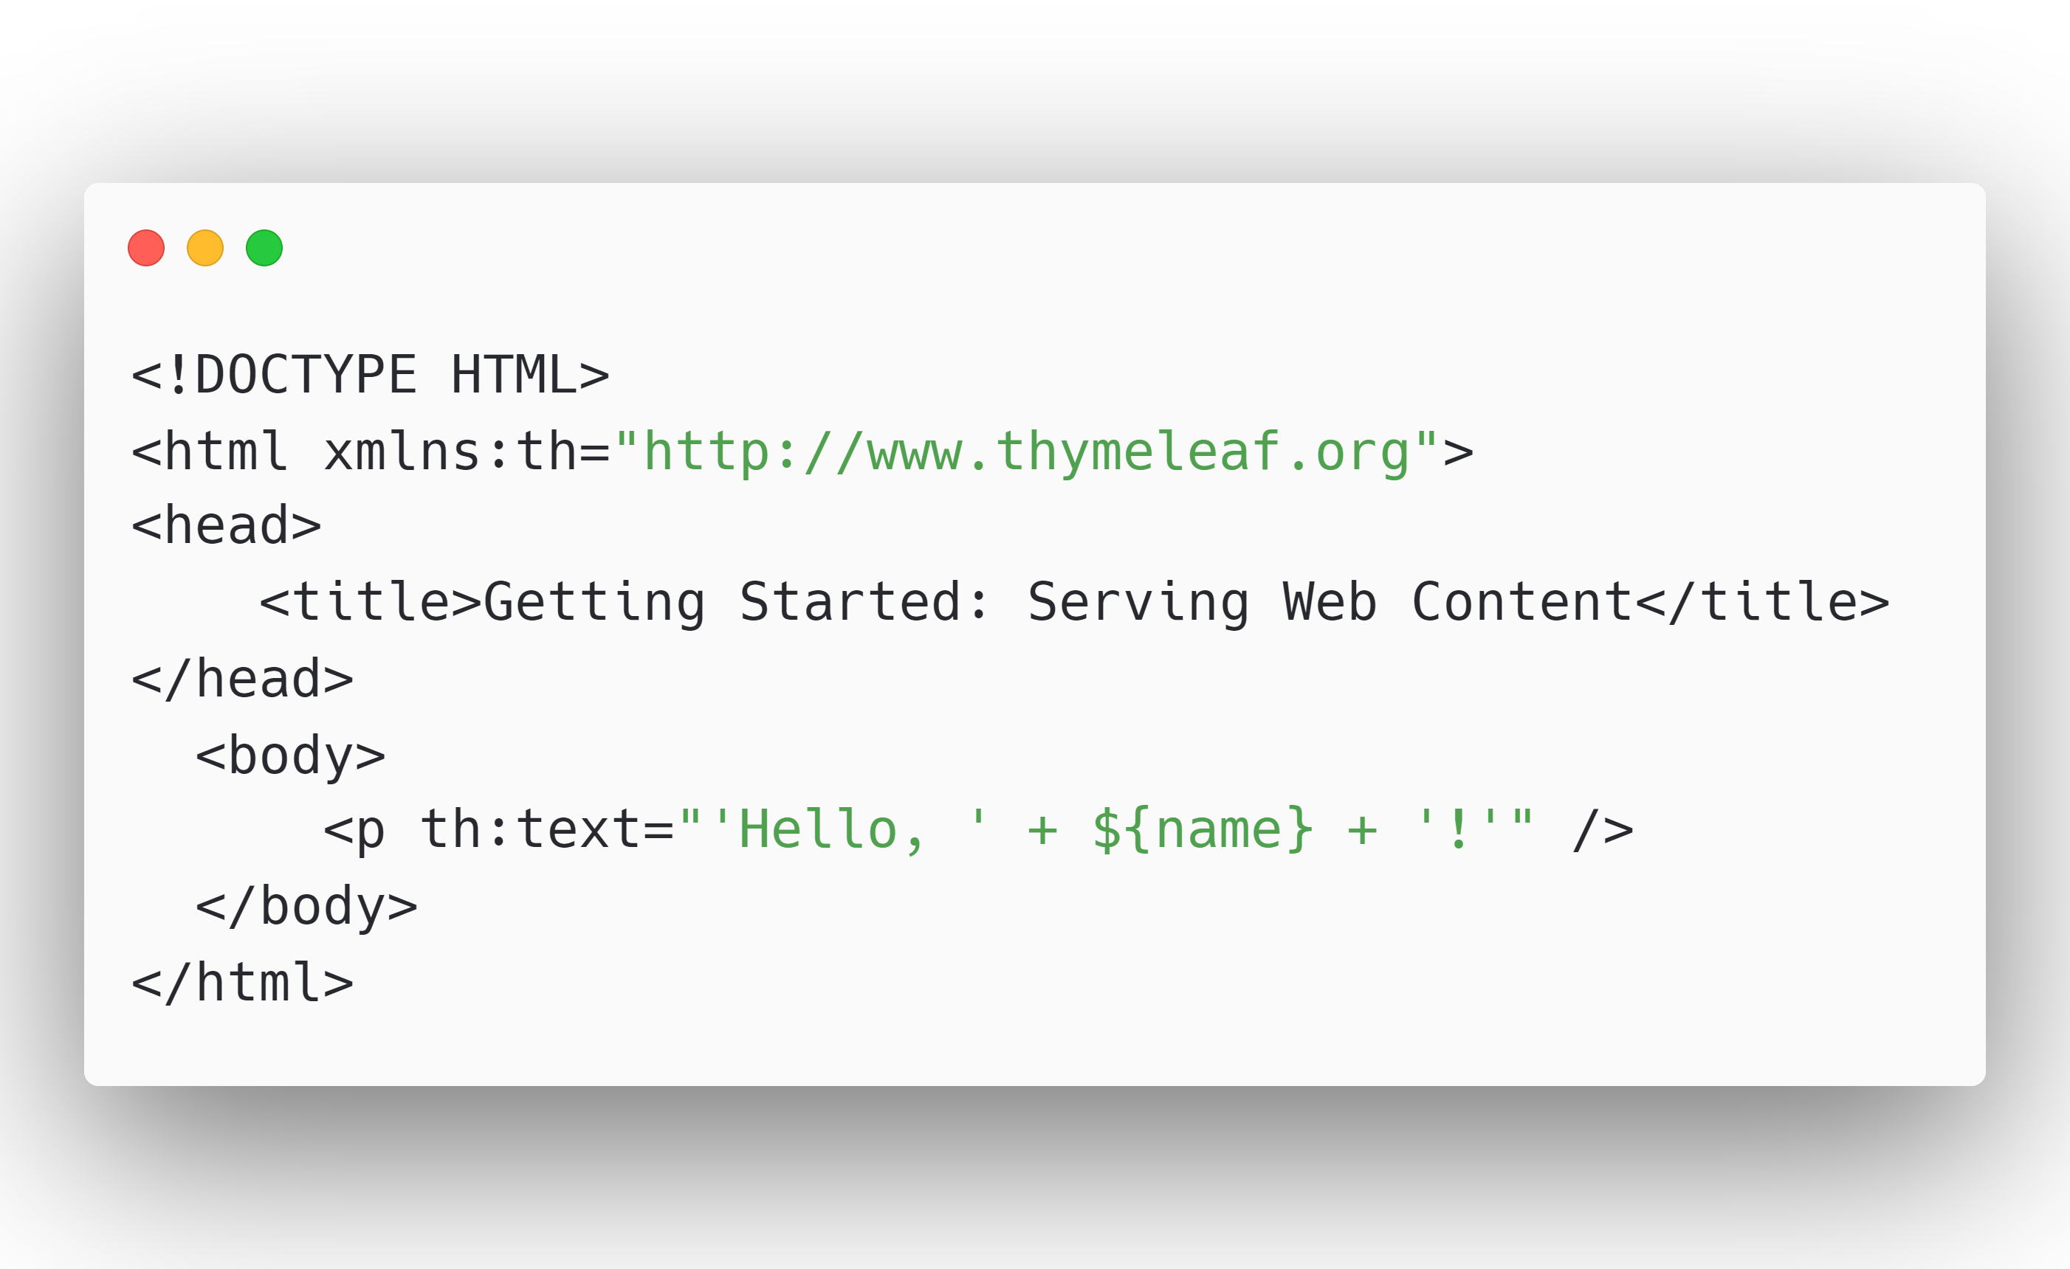
greeting.html

Slide 30
greeting.html

Slide 31
greeting.html

Slide 32
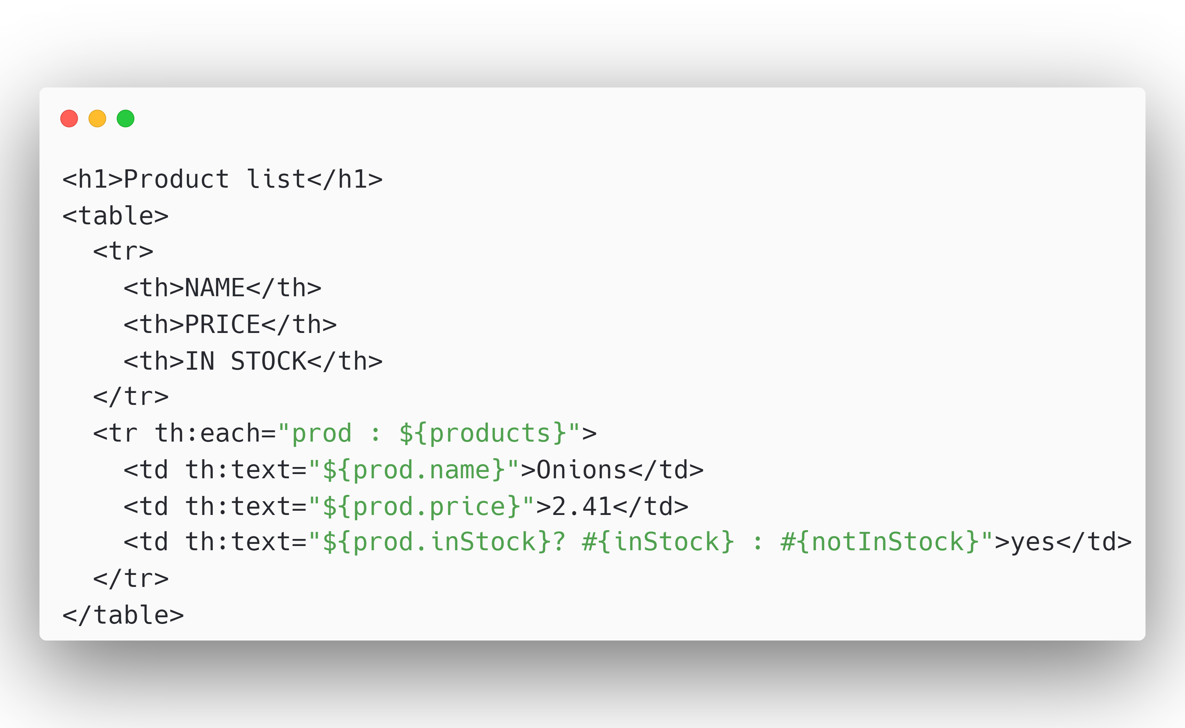
products.html

Slide 33
products.html

Slide 35
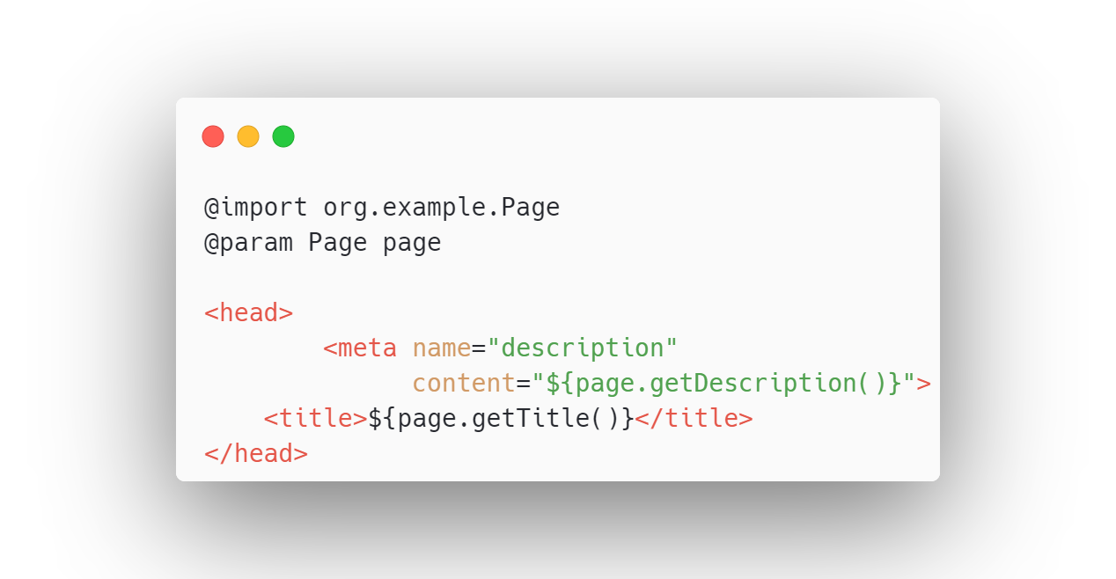
page.jte

Slide 36
page.jte

Slide 37
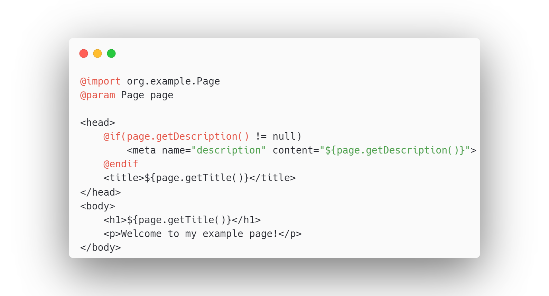
page.jte

Slide 38
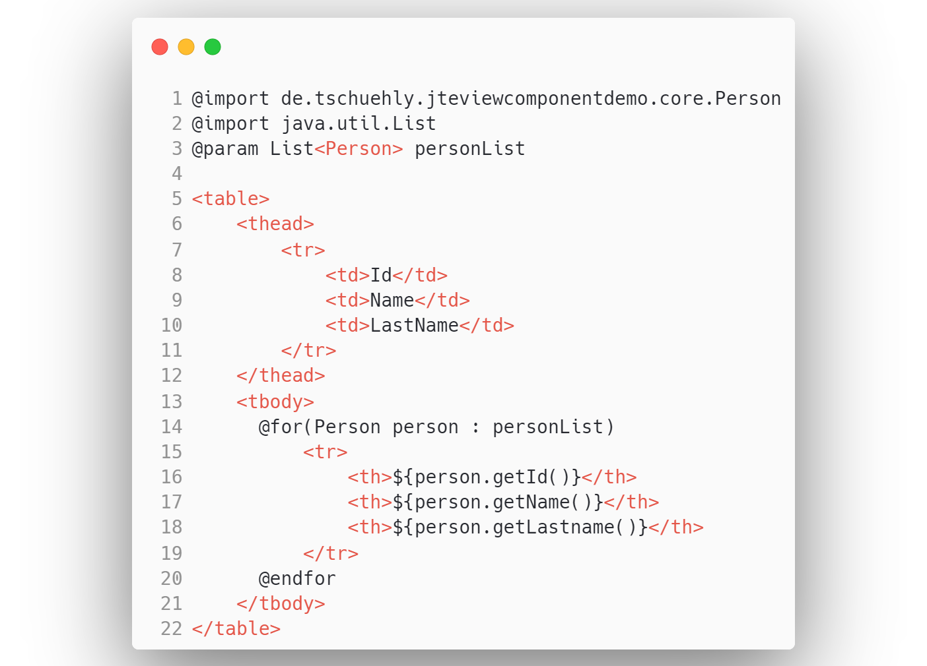
personlist.jte

Slide 40



Slide 41

github.com/tschuehly/spring-view-component

Slide 42
Template and Controller are tightly coupled
GreetingController.kt
greeting.html

Slide 43
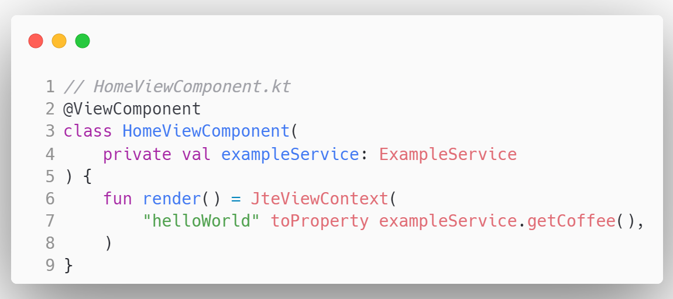
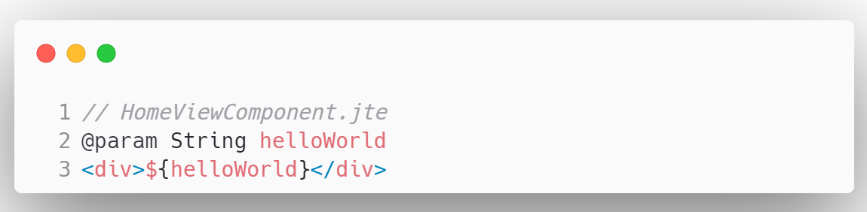

Slide 44
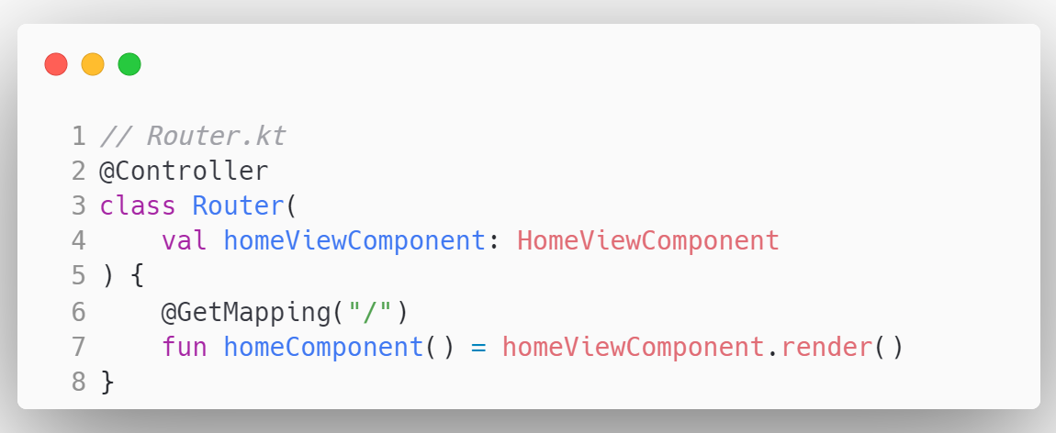
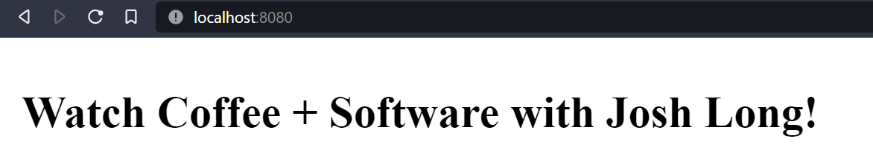

Slide 45
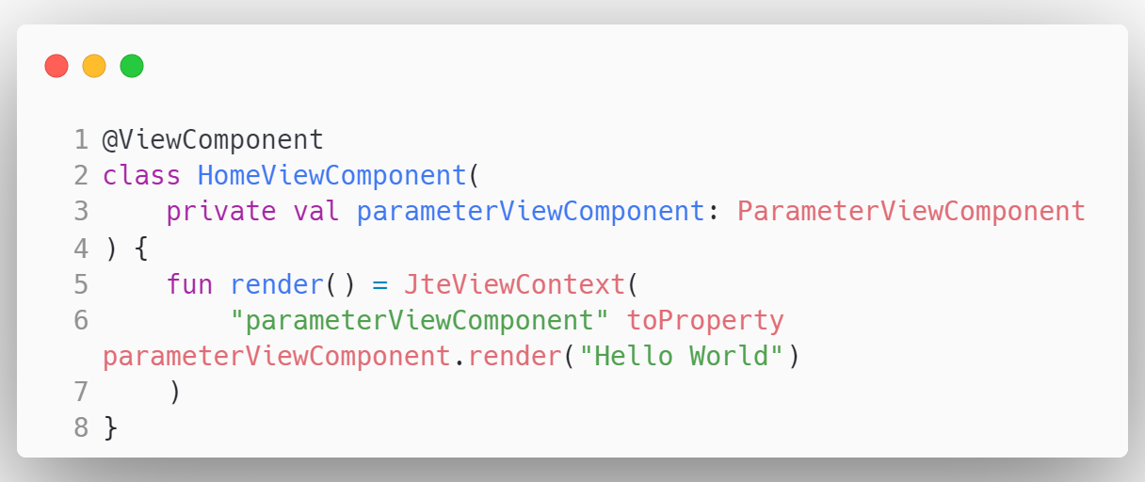
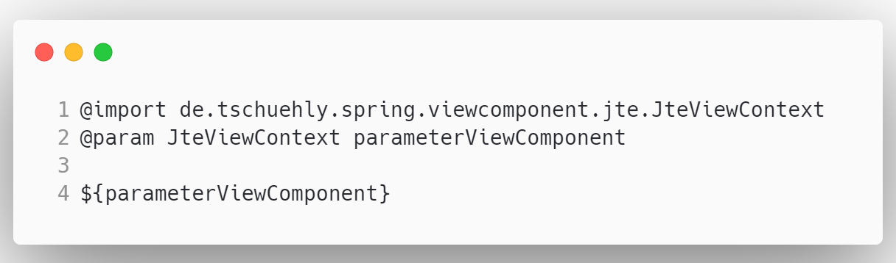

Slide 46
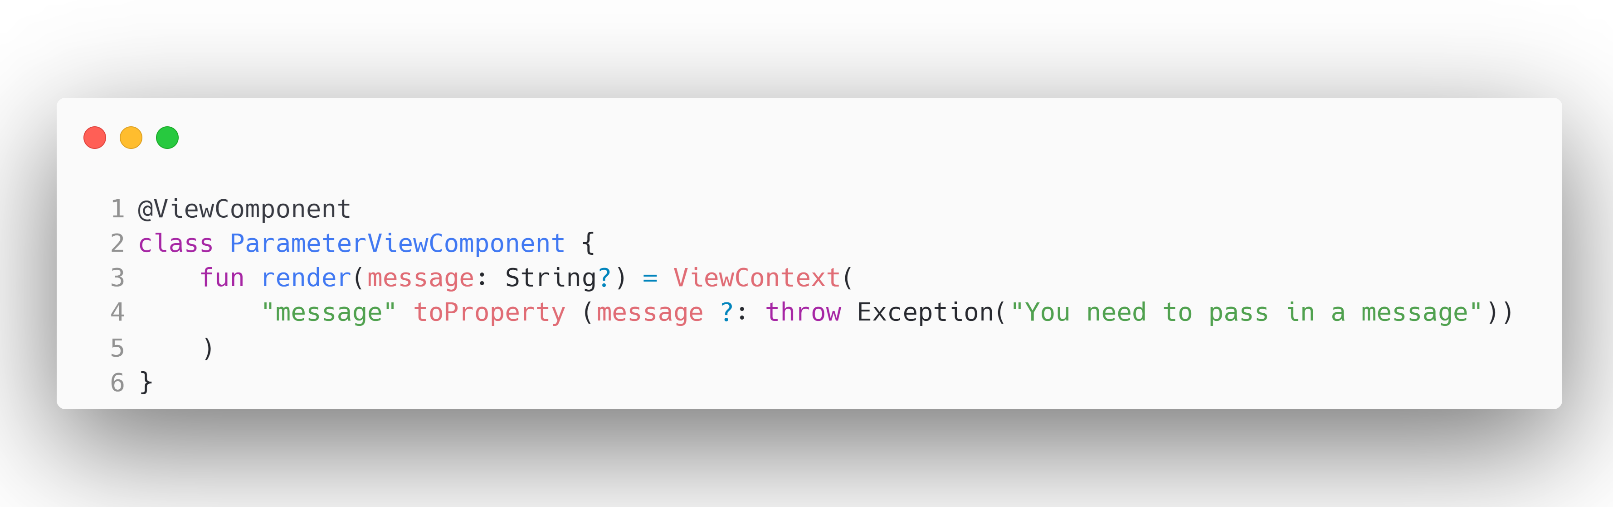

Slide 47
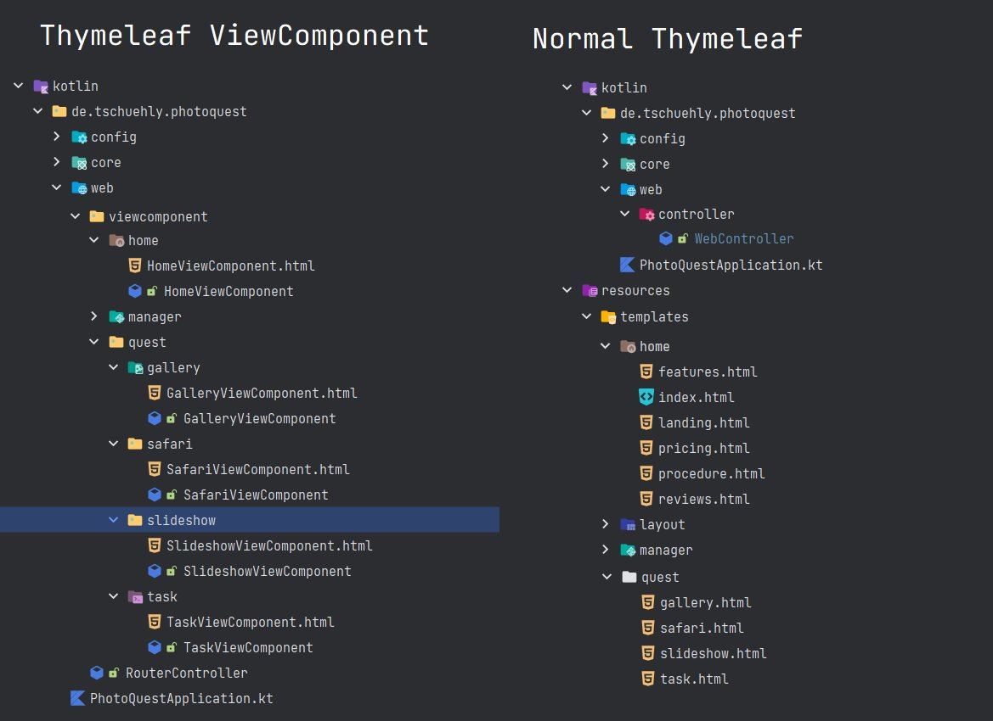

Slide 49
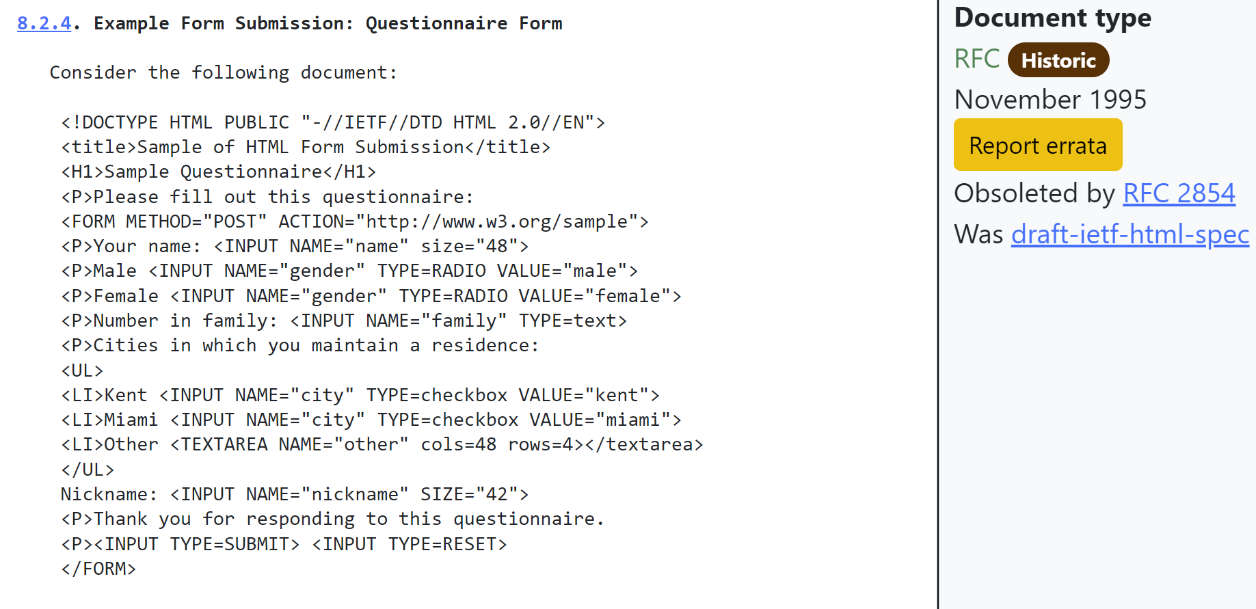

Slide 50
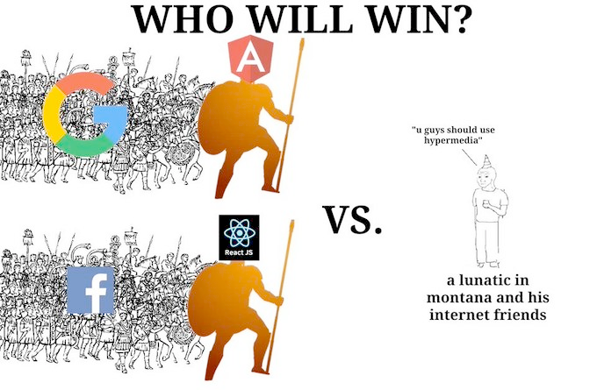

Slide 51


Slide 52
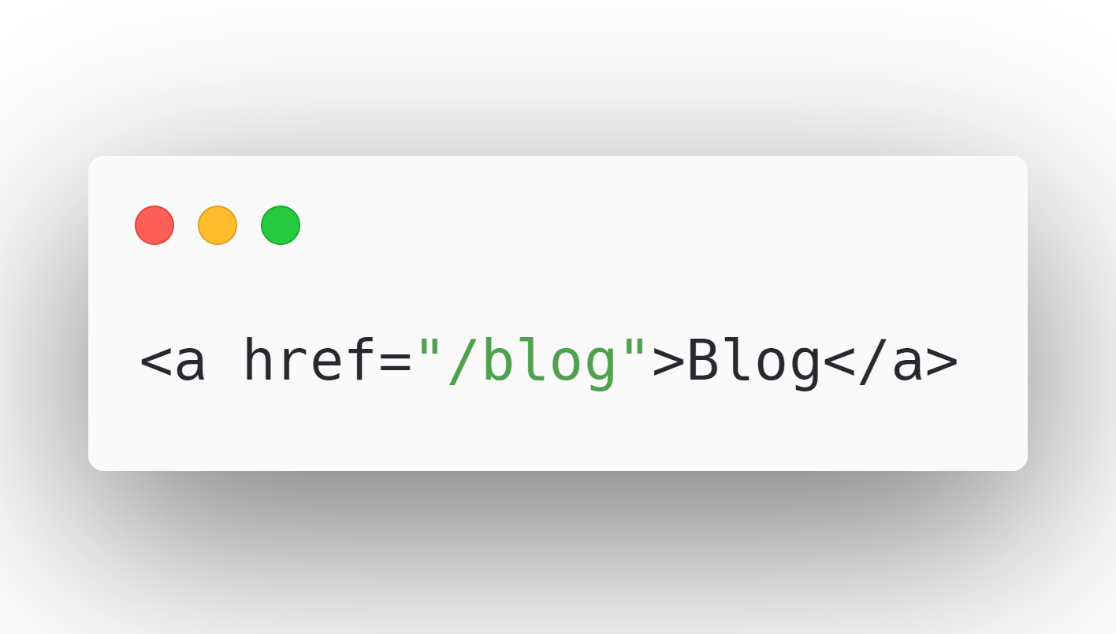

Slide 53
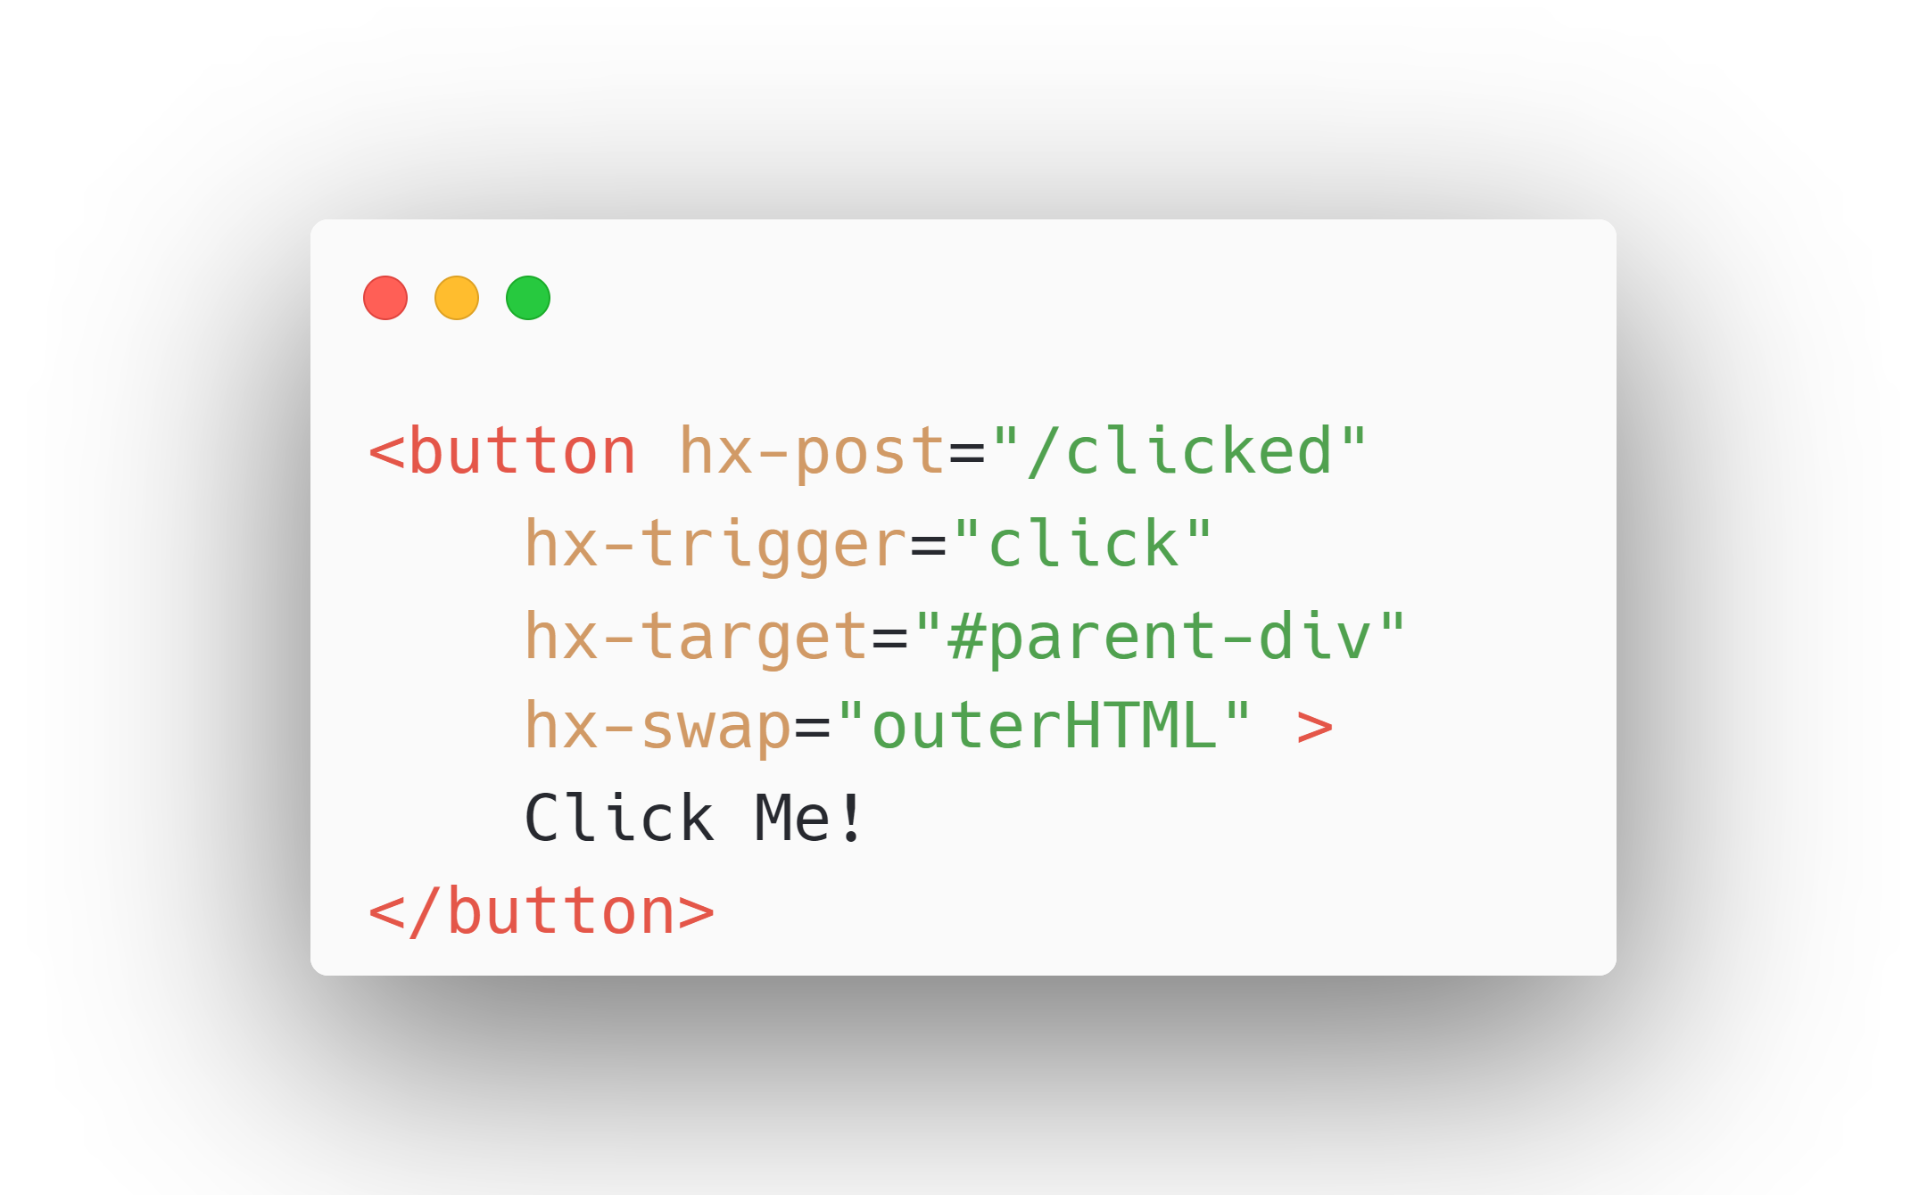

Slide 54
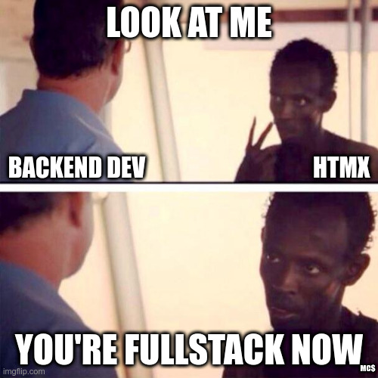

Slide 55
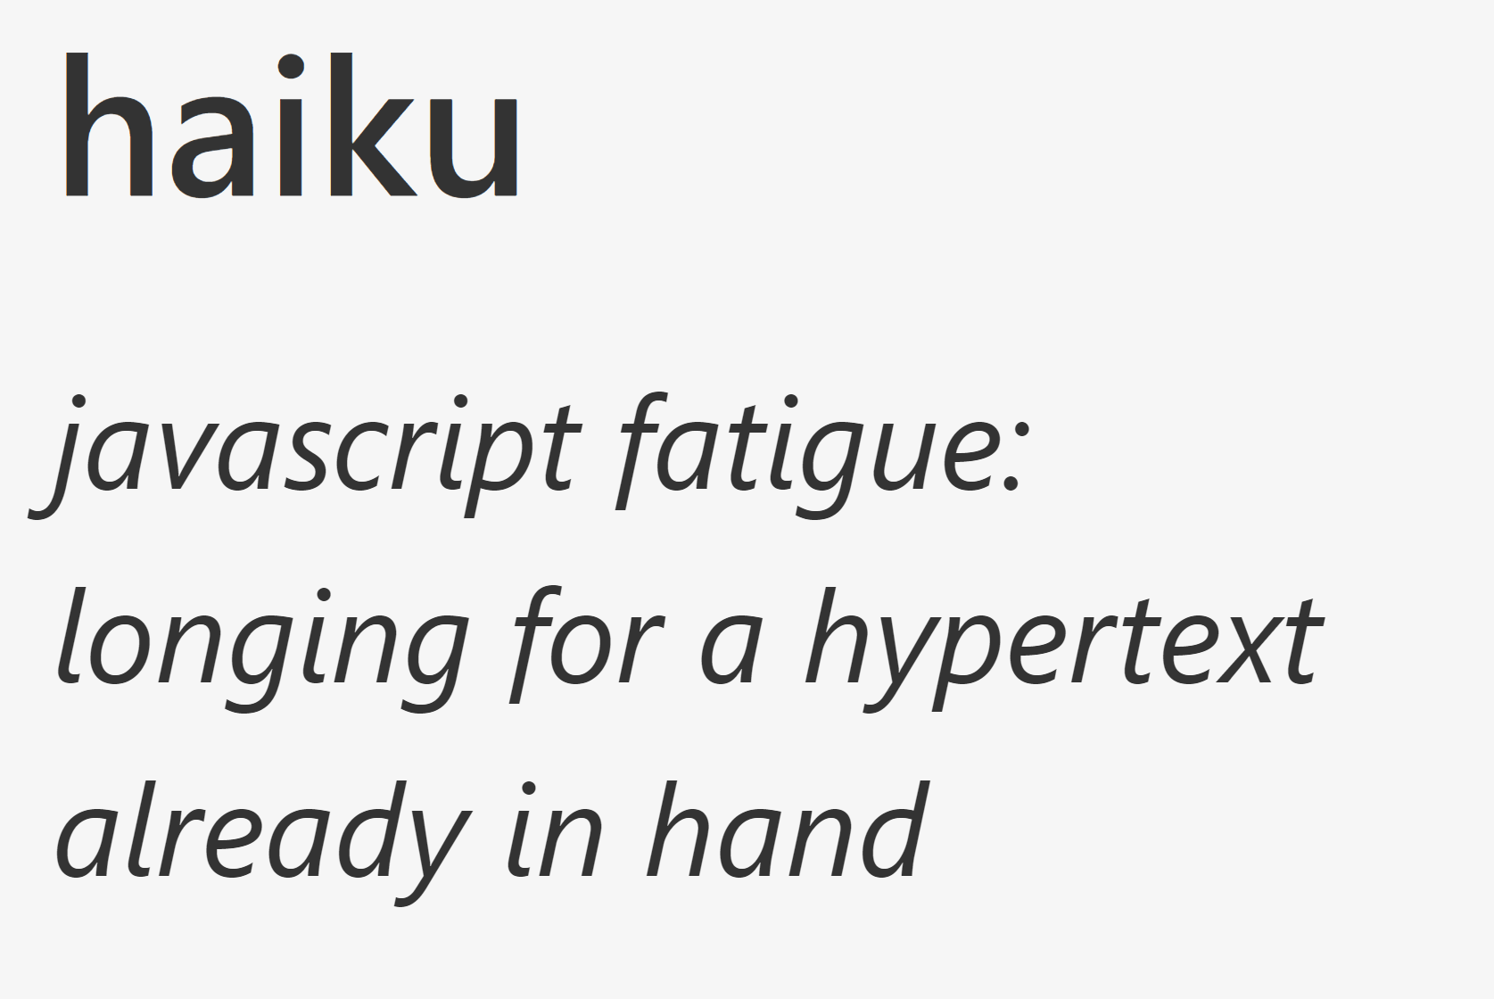

Slide 56
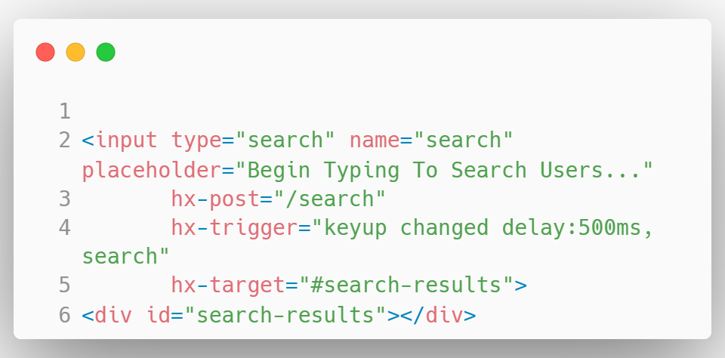

Slide 57
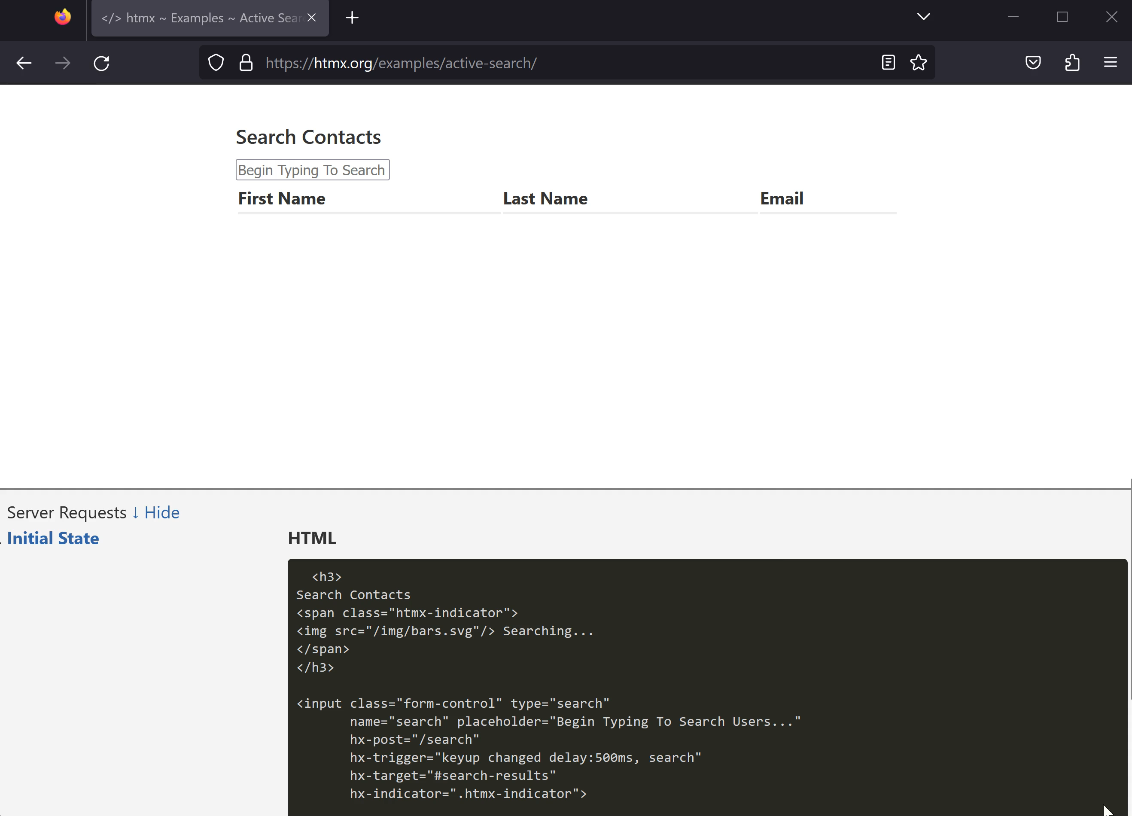

Slide 58
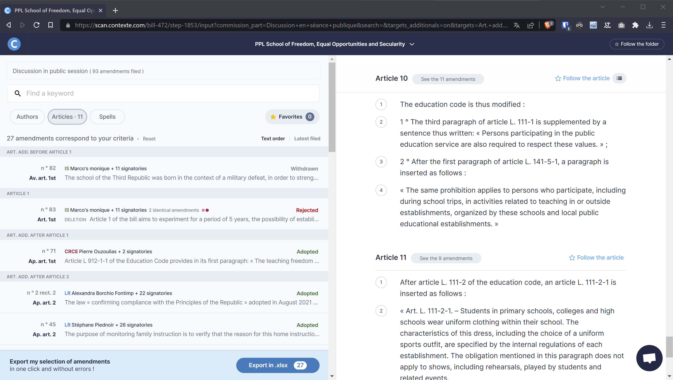

Slide 60
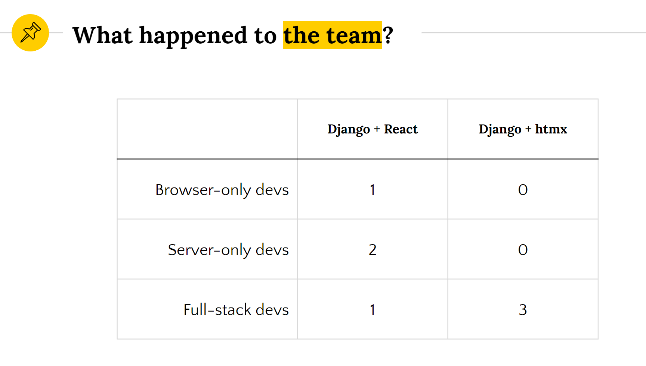
Software as a Service Startup „Contexte“

Slide 61
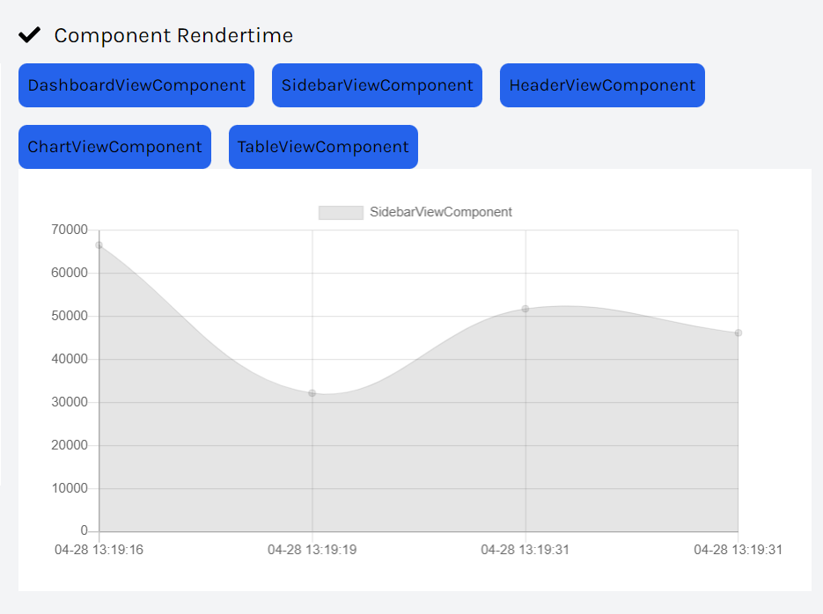

Slide 62
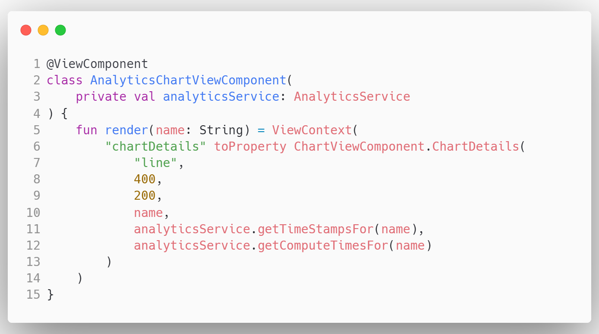

Slide 63
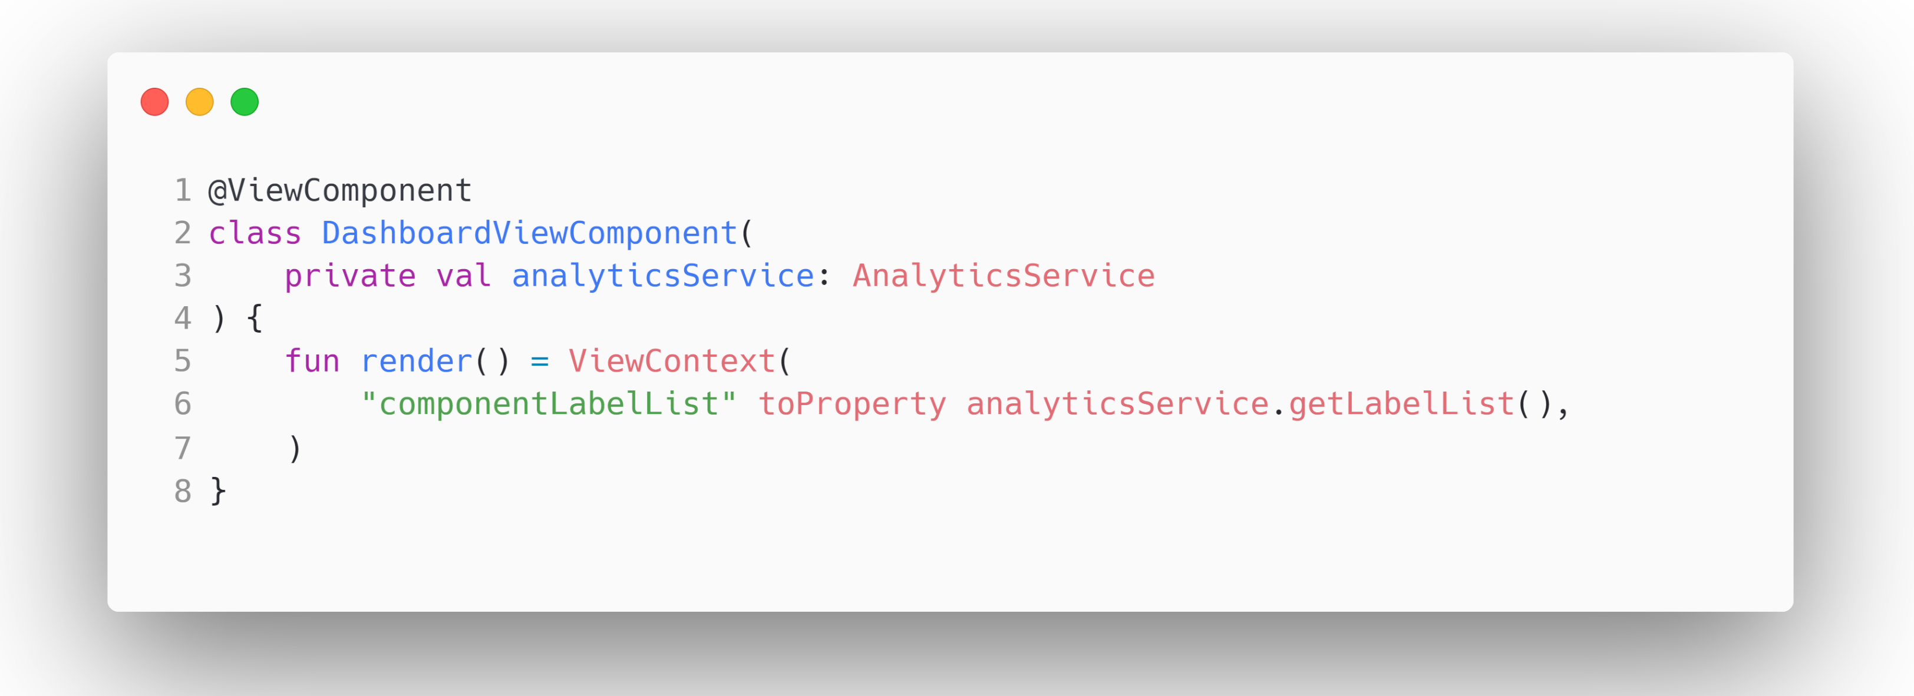
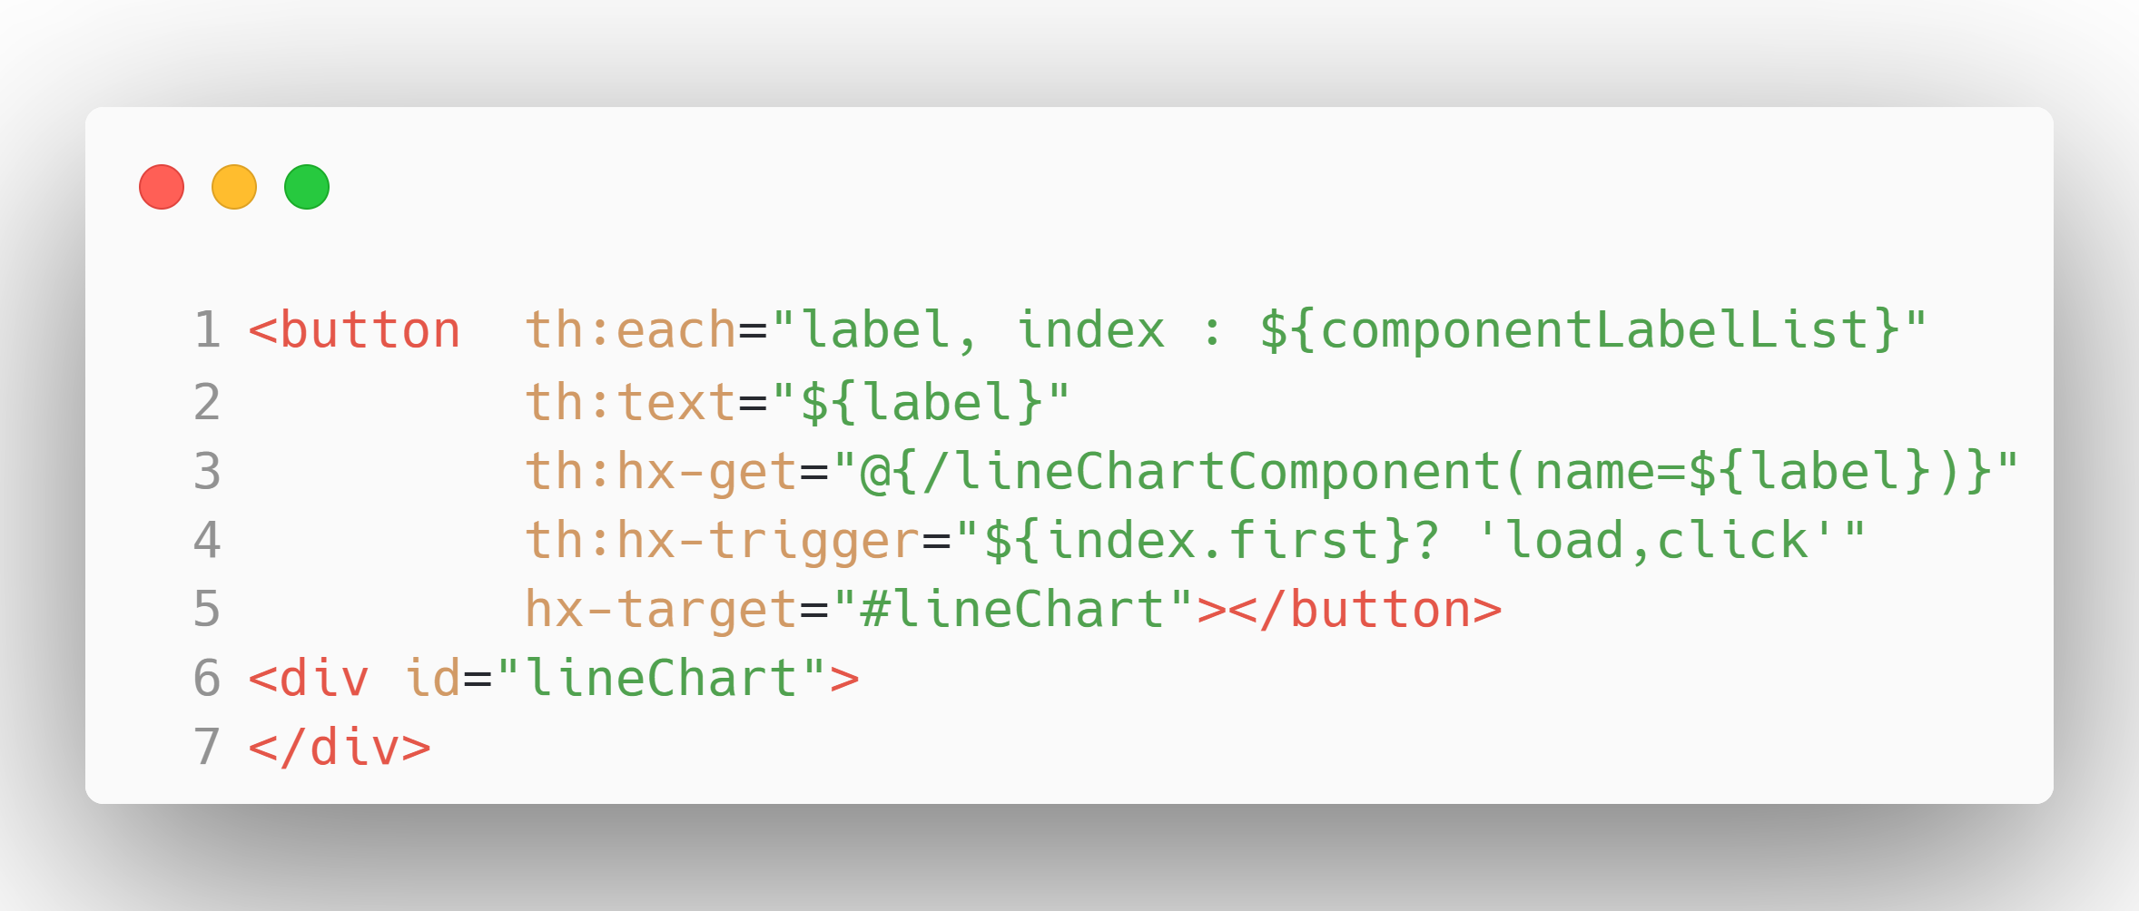
DashboardViewComponent.kt
DashboardViewComponent.html

Slide 64
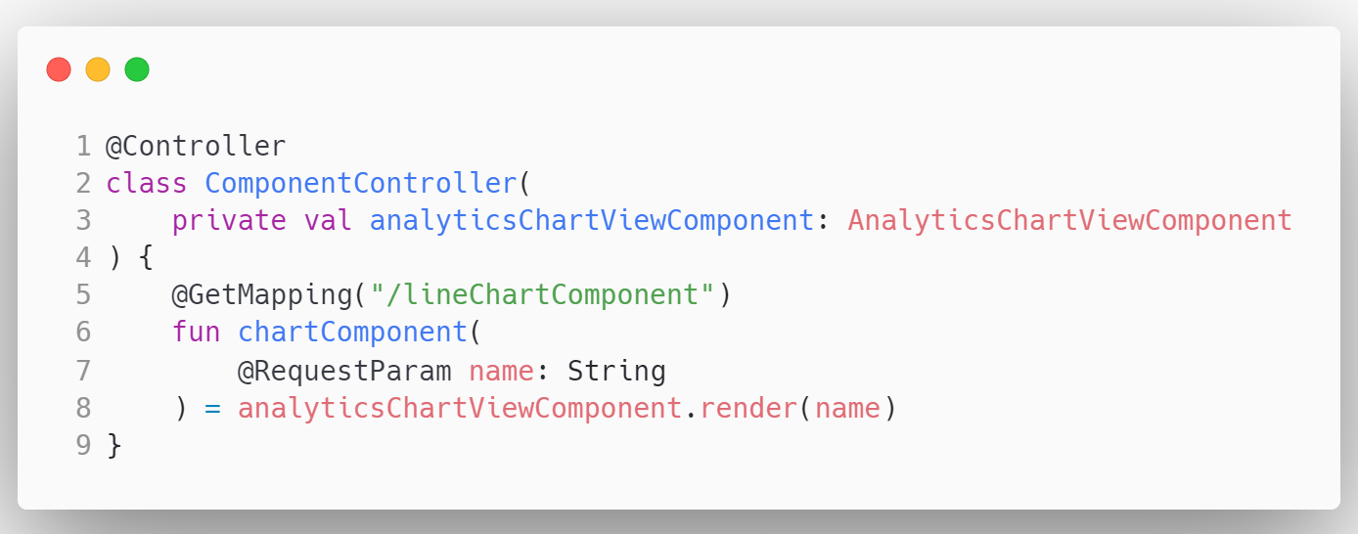

Slide 65
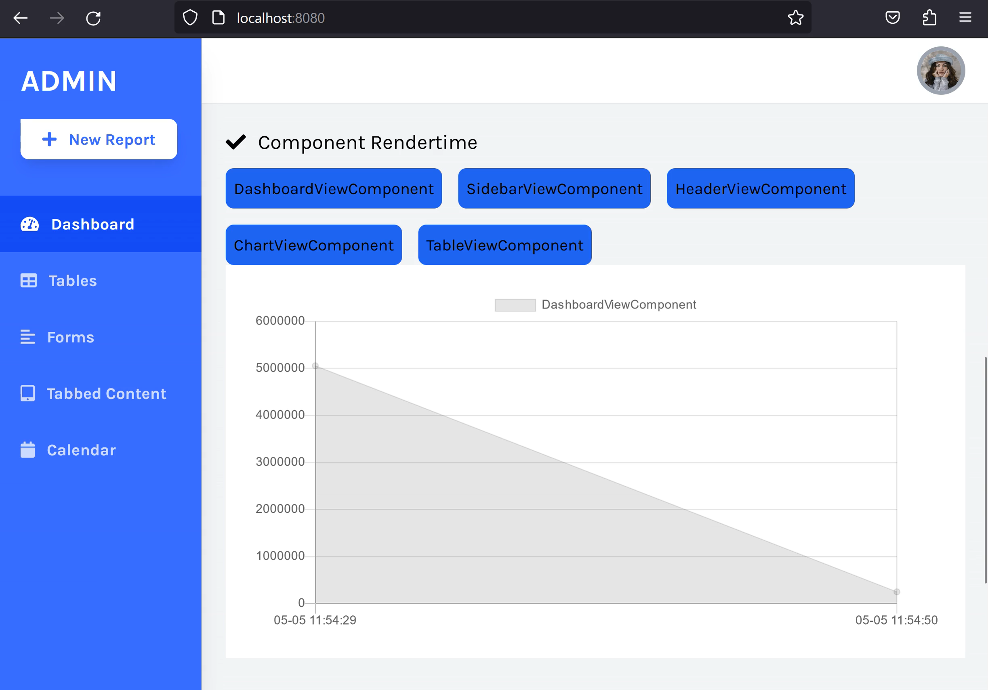

Slide 66
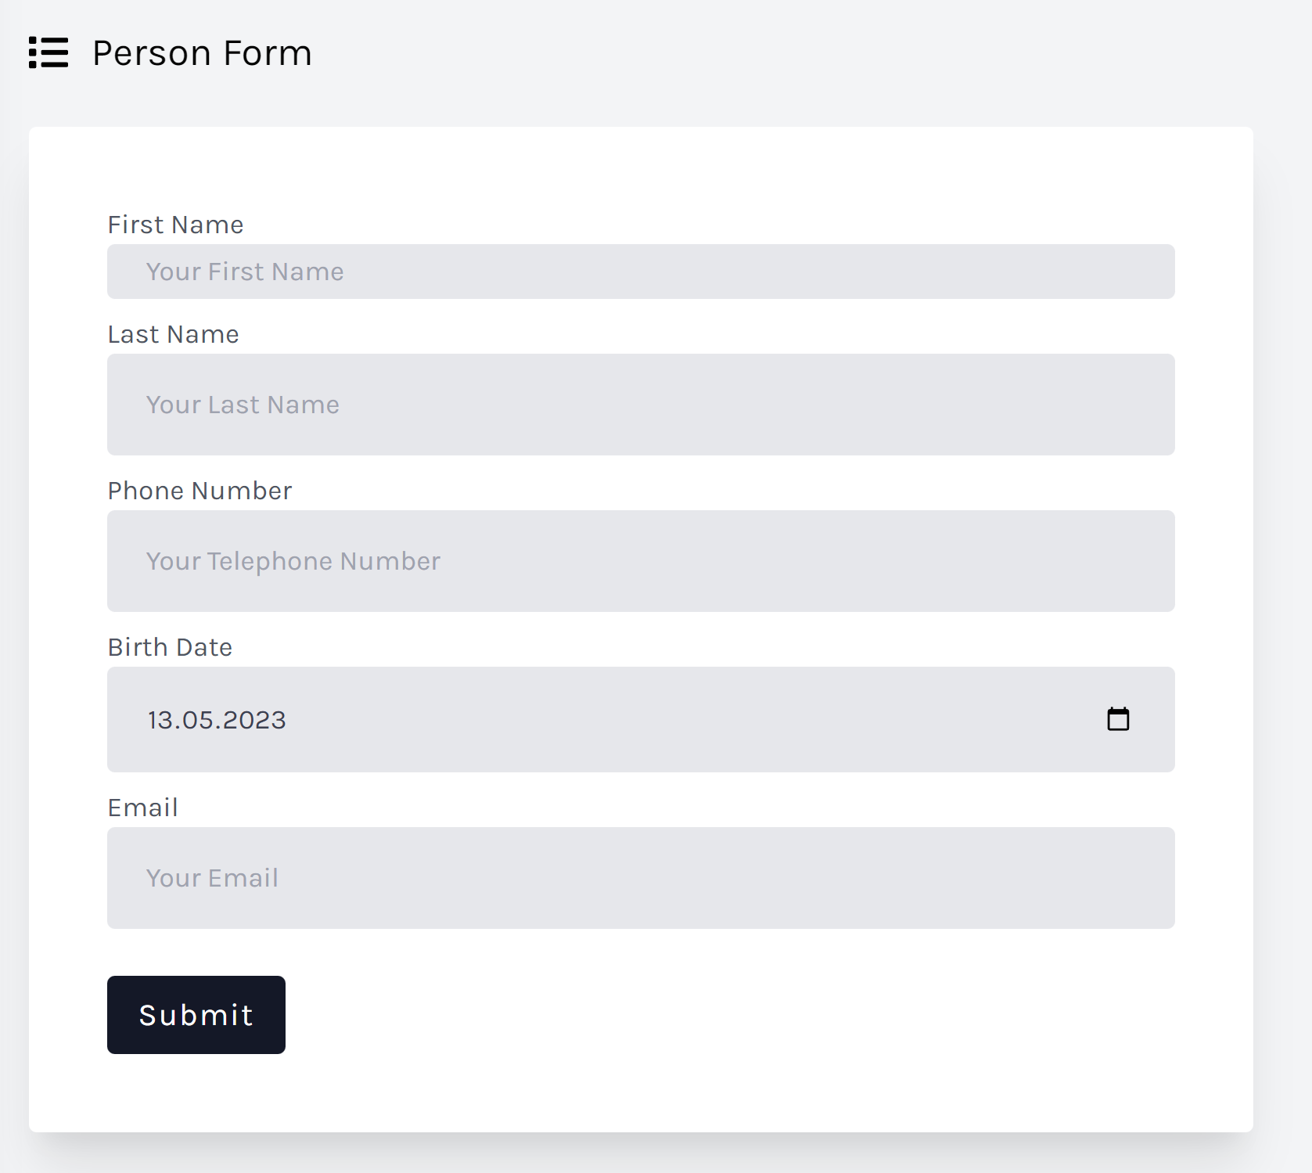

Slide 67
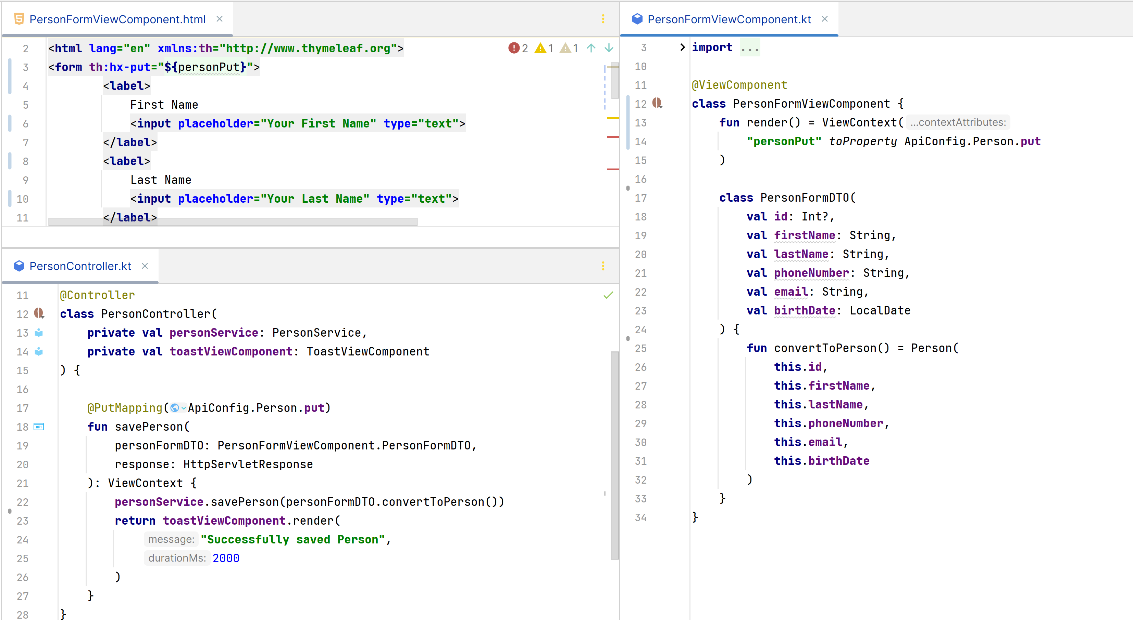

Slide 70
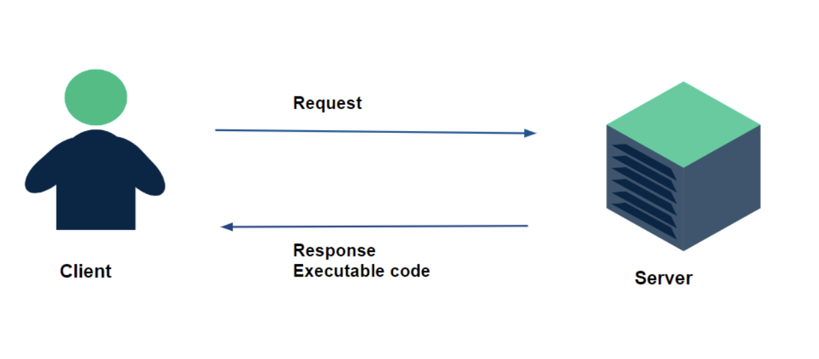

Slide 71
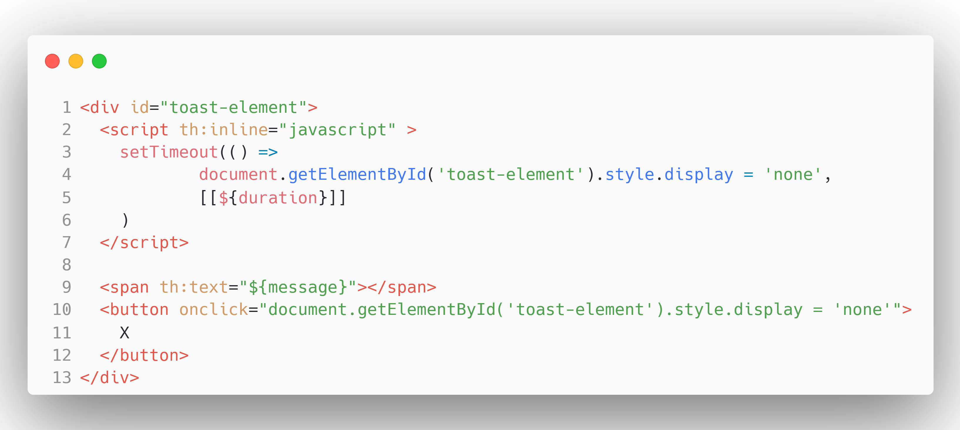
ToastViewComponent.html

Slide 72


Slide 73
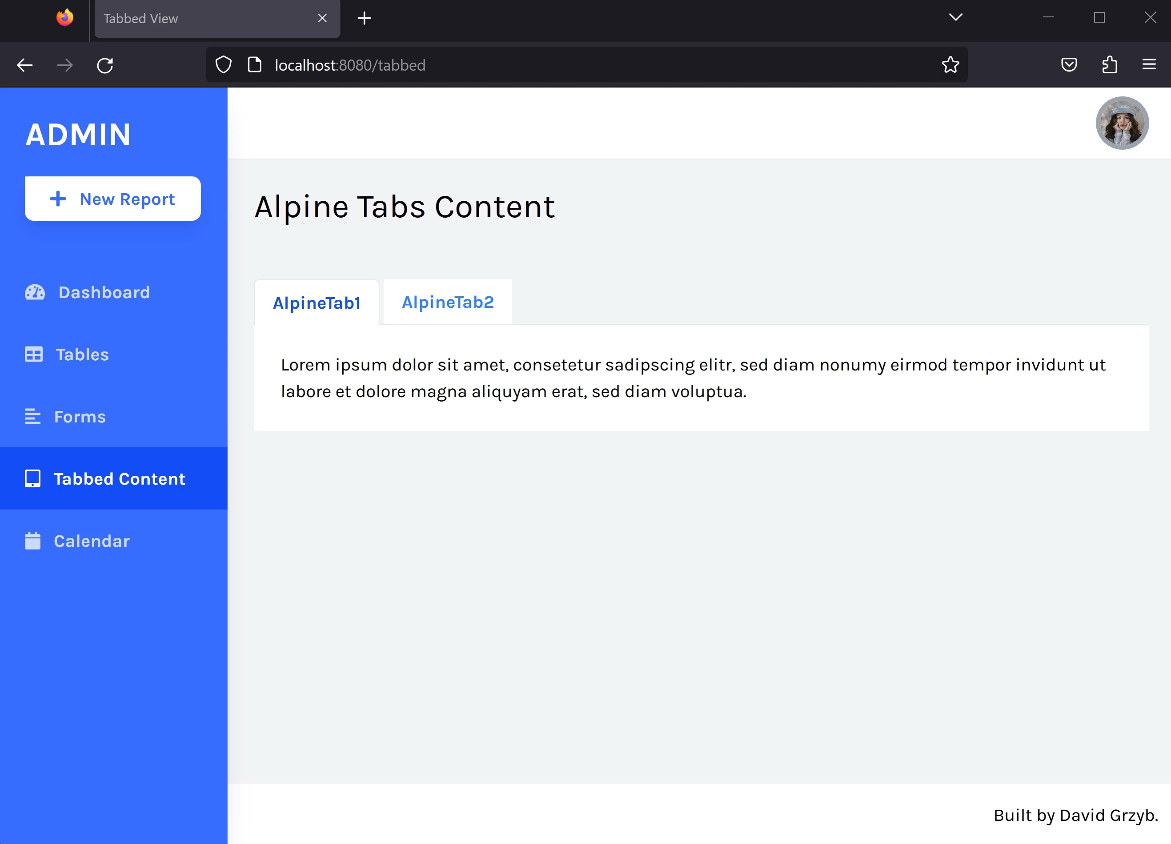

Slide 74
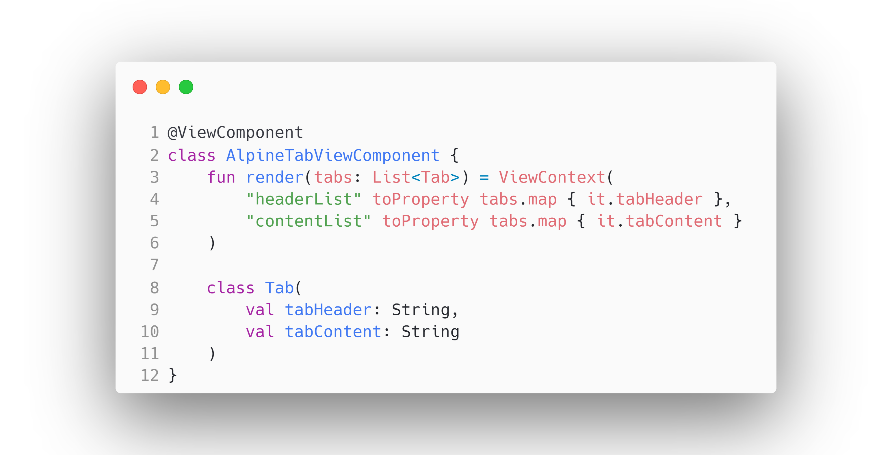
AlpineTabViewComponent.kt

Slide 75
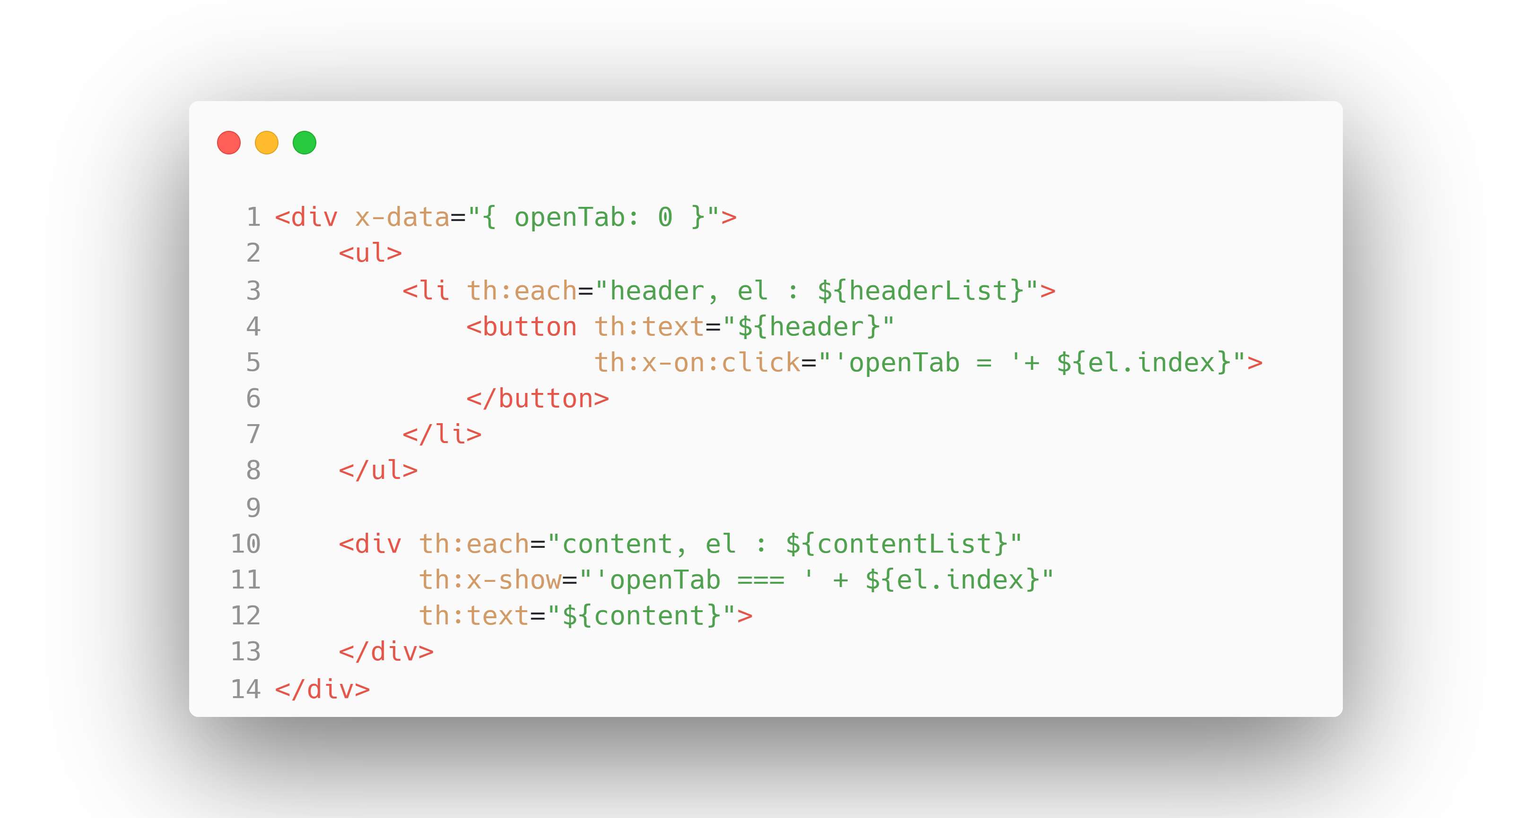
AlpineTabViewComponent.html

Slide 76
AlpineTabViewComponent.html

Slide 77
AlpineTabViewComponent.html

Slide 78
AlpineTabViewComponent.html

Slide 79
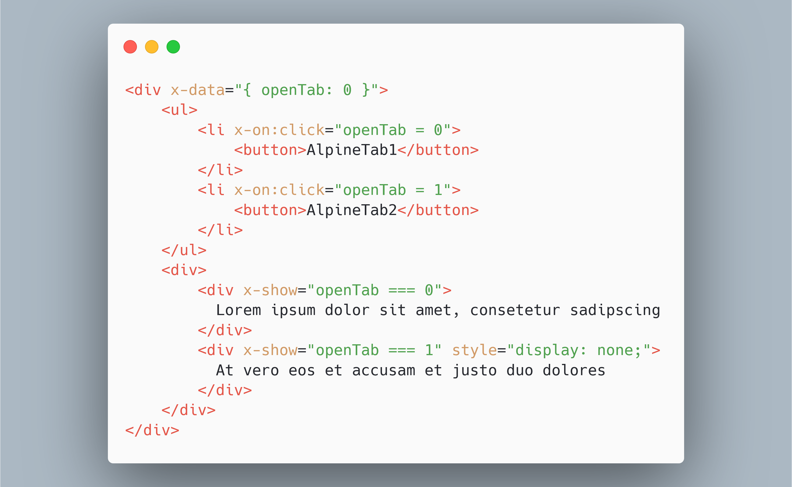

Slide 80


Slide 81

github.com/tschuehly/supabase-security-spring-boot-starter

Slide 82



Hosted PostgreSQL
Hosted GoTrue Authentication Server

Slide 83
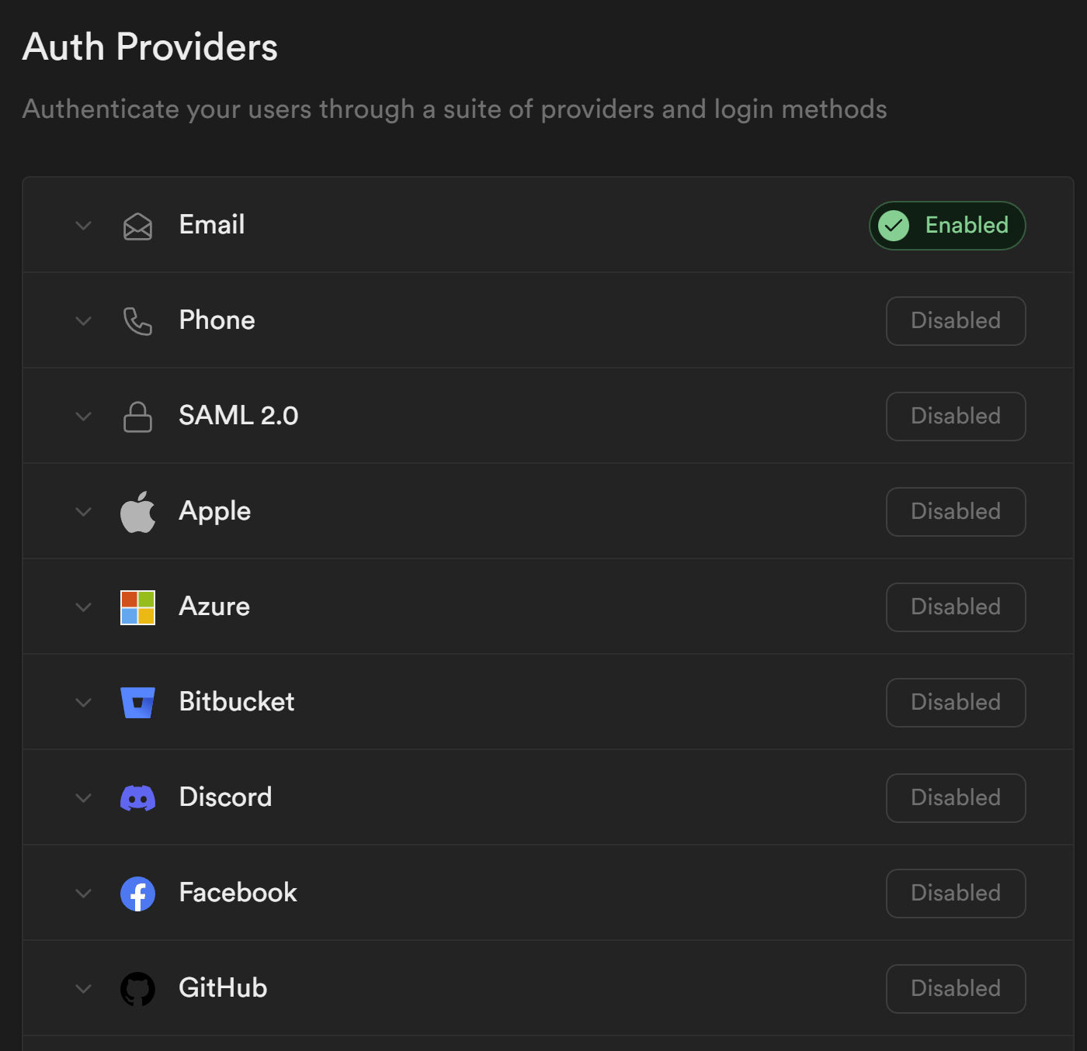
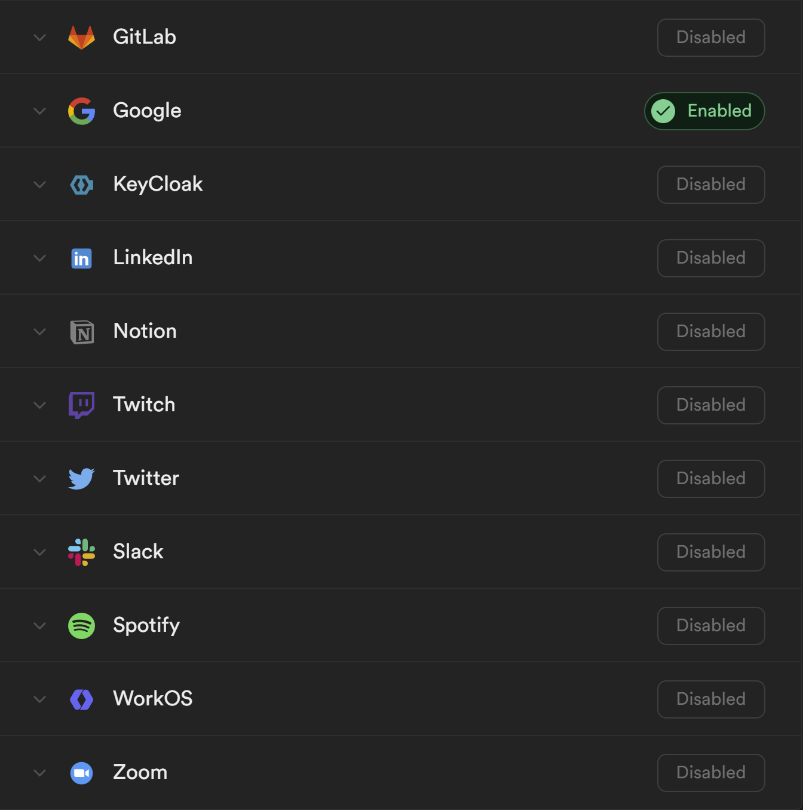

Slide 84
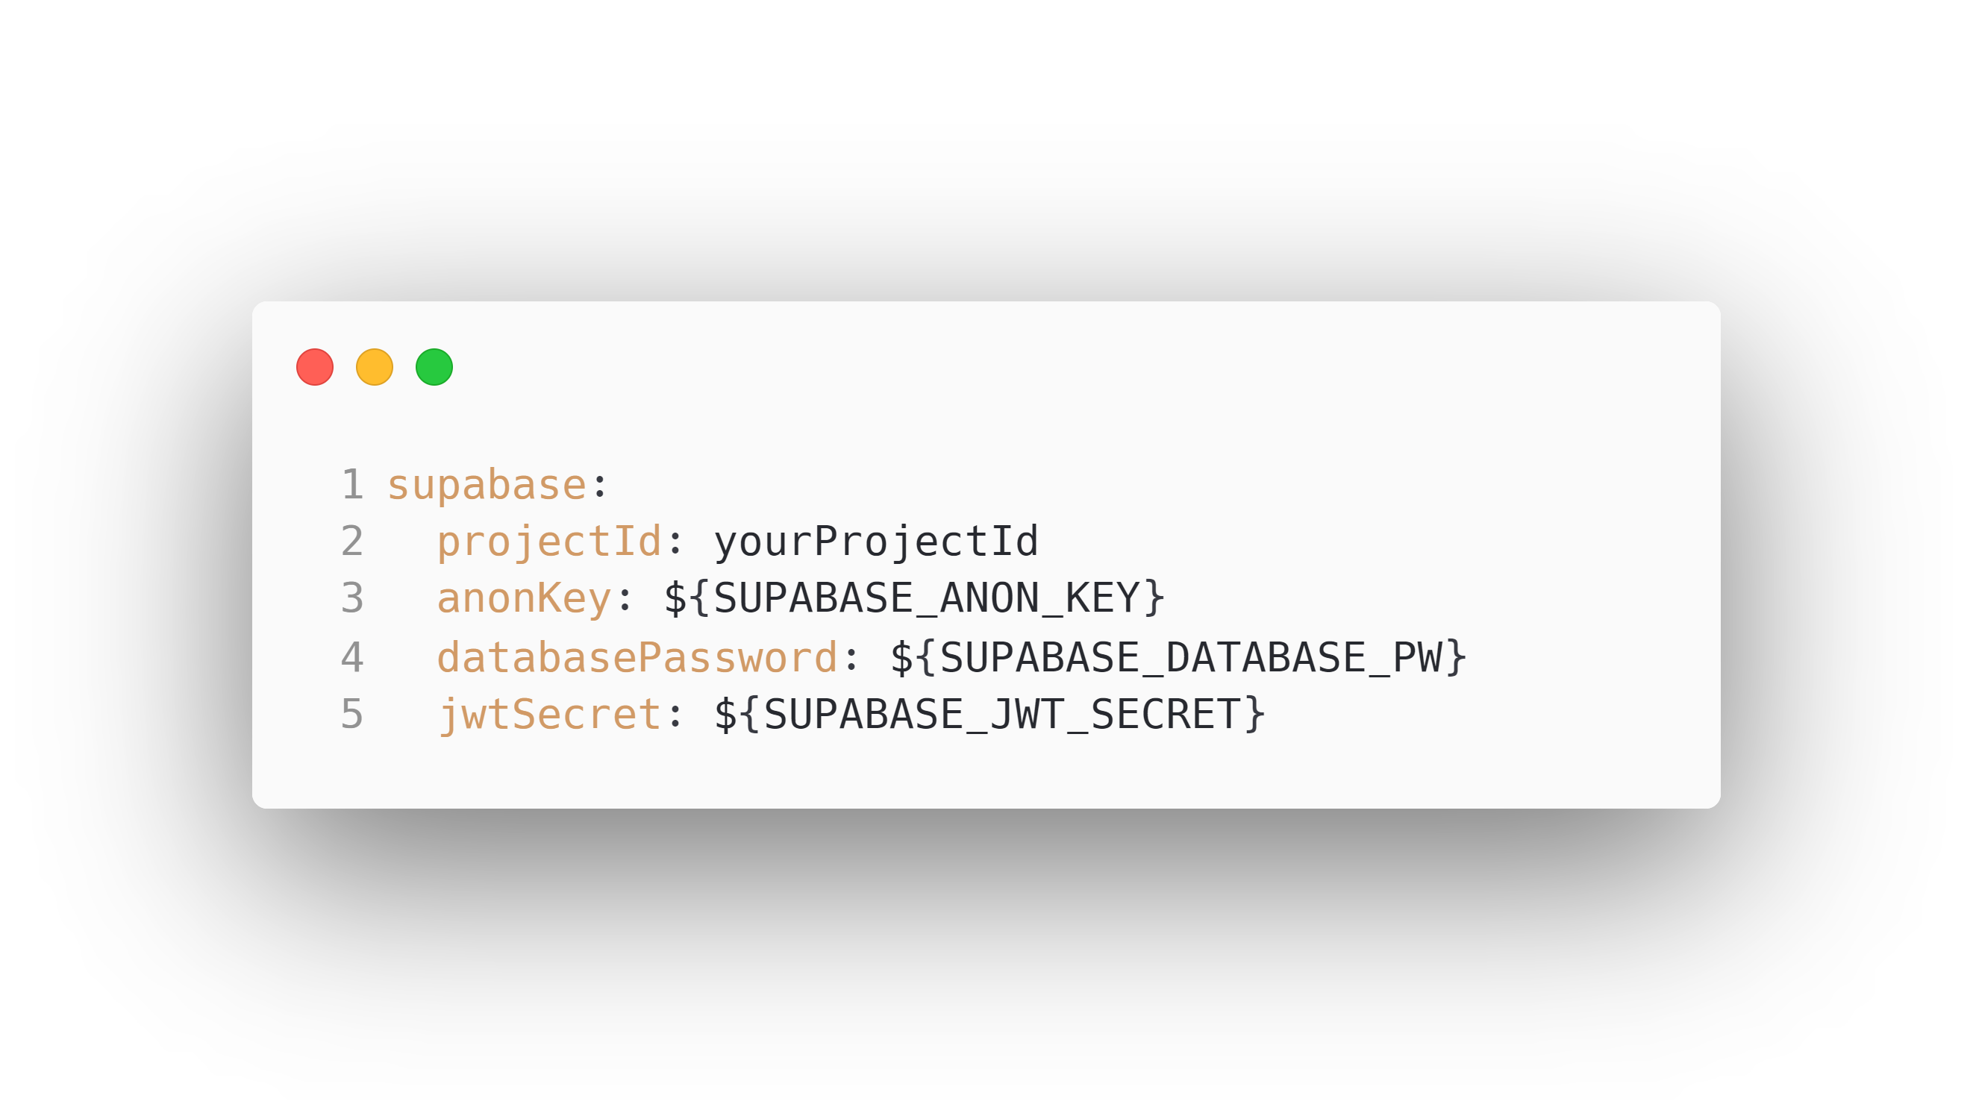

Slide 85


Slide 86


Slide 87


Slide 88


Slide 90


Slide 91


Slide 92


Slide 93


Slide 94


Slide 95


Slide 96


Slide 97


Slide 98


fullstack.tschuehly.de
github.com/tschuehly/rapid-fullstack-demo

Slide 99


Slide 100


Slide 101


